Slide 1
Session 2 The Evolving Role of the CFO | October 18, 2023

Slide 2
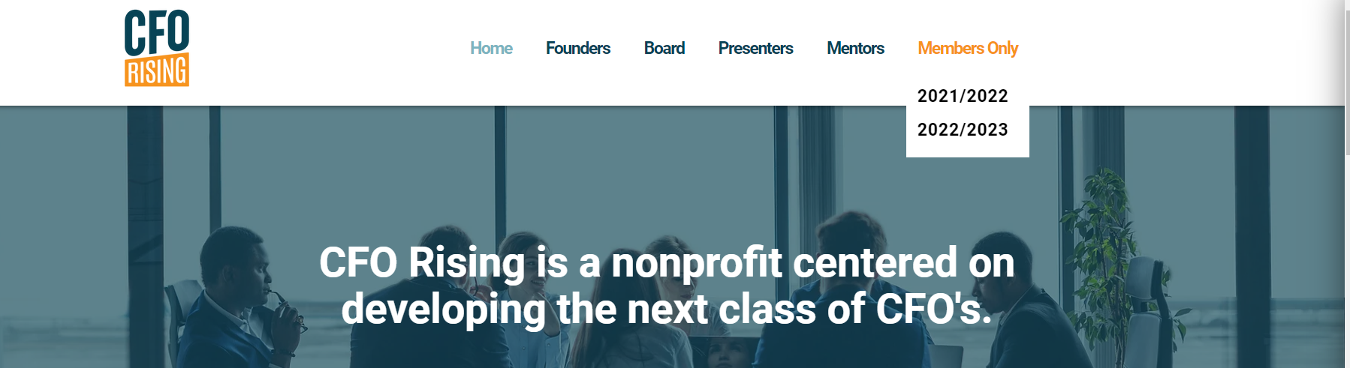
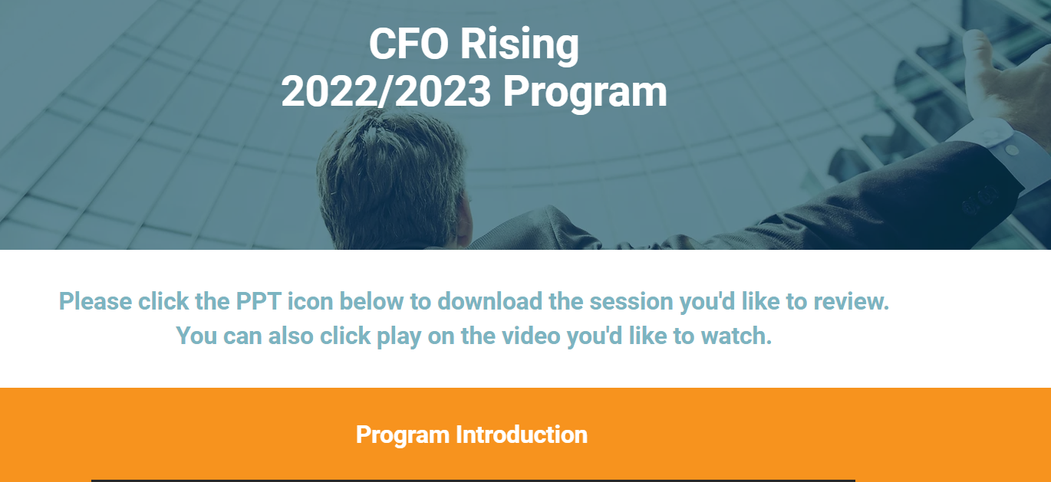
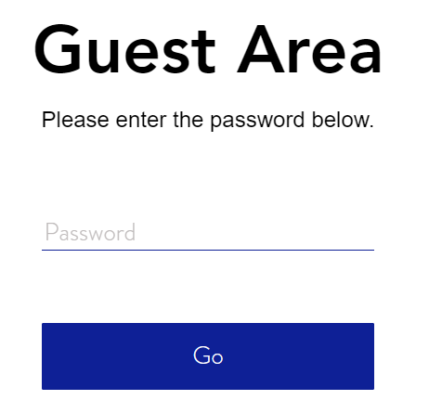
Logistics
We will be storing all the recorded sessions on our website under the “Members Only” section.
If you have any trouble accessing, please contact Kate for assistance.
www.cforising.org
CFORisingMember
Notes:
Mandatory slide of the presenter’s Bio. Presenter to craft as they see fit.

Slide 3
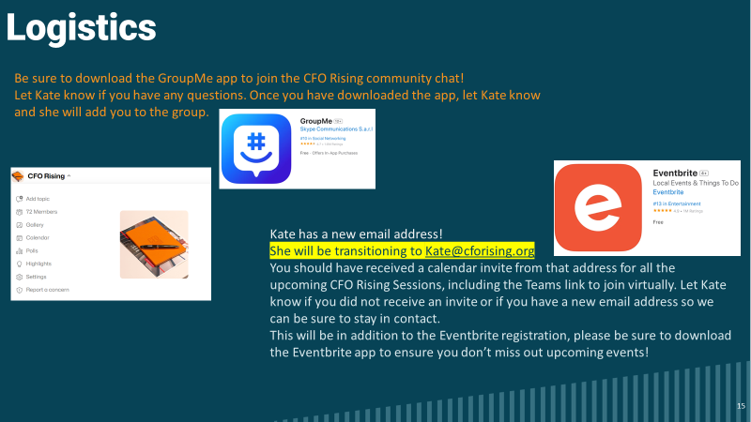

Slide 4
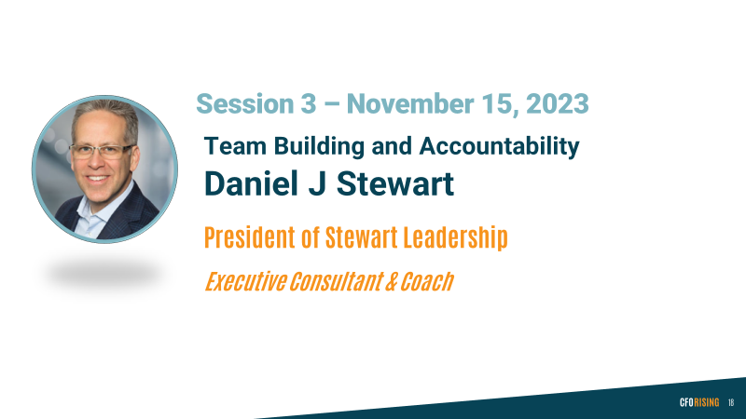

Slide 5

Special Guests
      Brandywine Realty Trust
      Jerry A. Kilkenny
      Vice President of Leasing, Metro DC
      And
      Stephanie Morgan
      Senior Leasing Associate
        Brandywine Realty Trust
Notes:
Mandatory Slide to introduce the next topic/session. To be briefed by the MC.

Slide 6

Tonight’s Agenda
  CLIMB: Coach, Learn, Inform, Mentor, Benefit
Becoming a CFO
Typical CFO Responsibilities
Break-out Session
Expansion of the CFO’s Role
Q&A
Notes:
Mandatory slide to suggest the Goals for the Session. White space at right is flexible as needed.

Slide 7
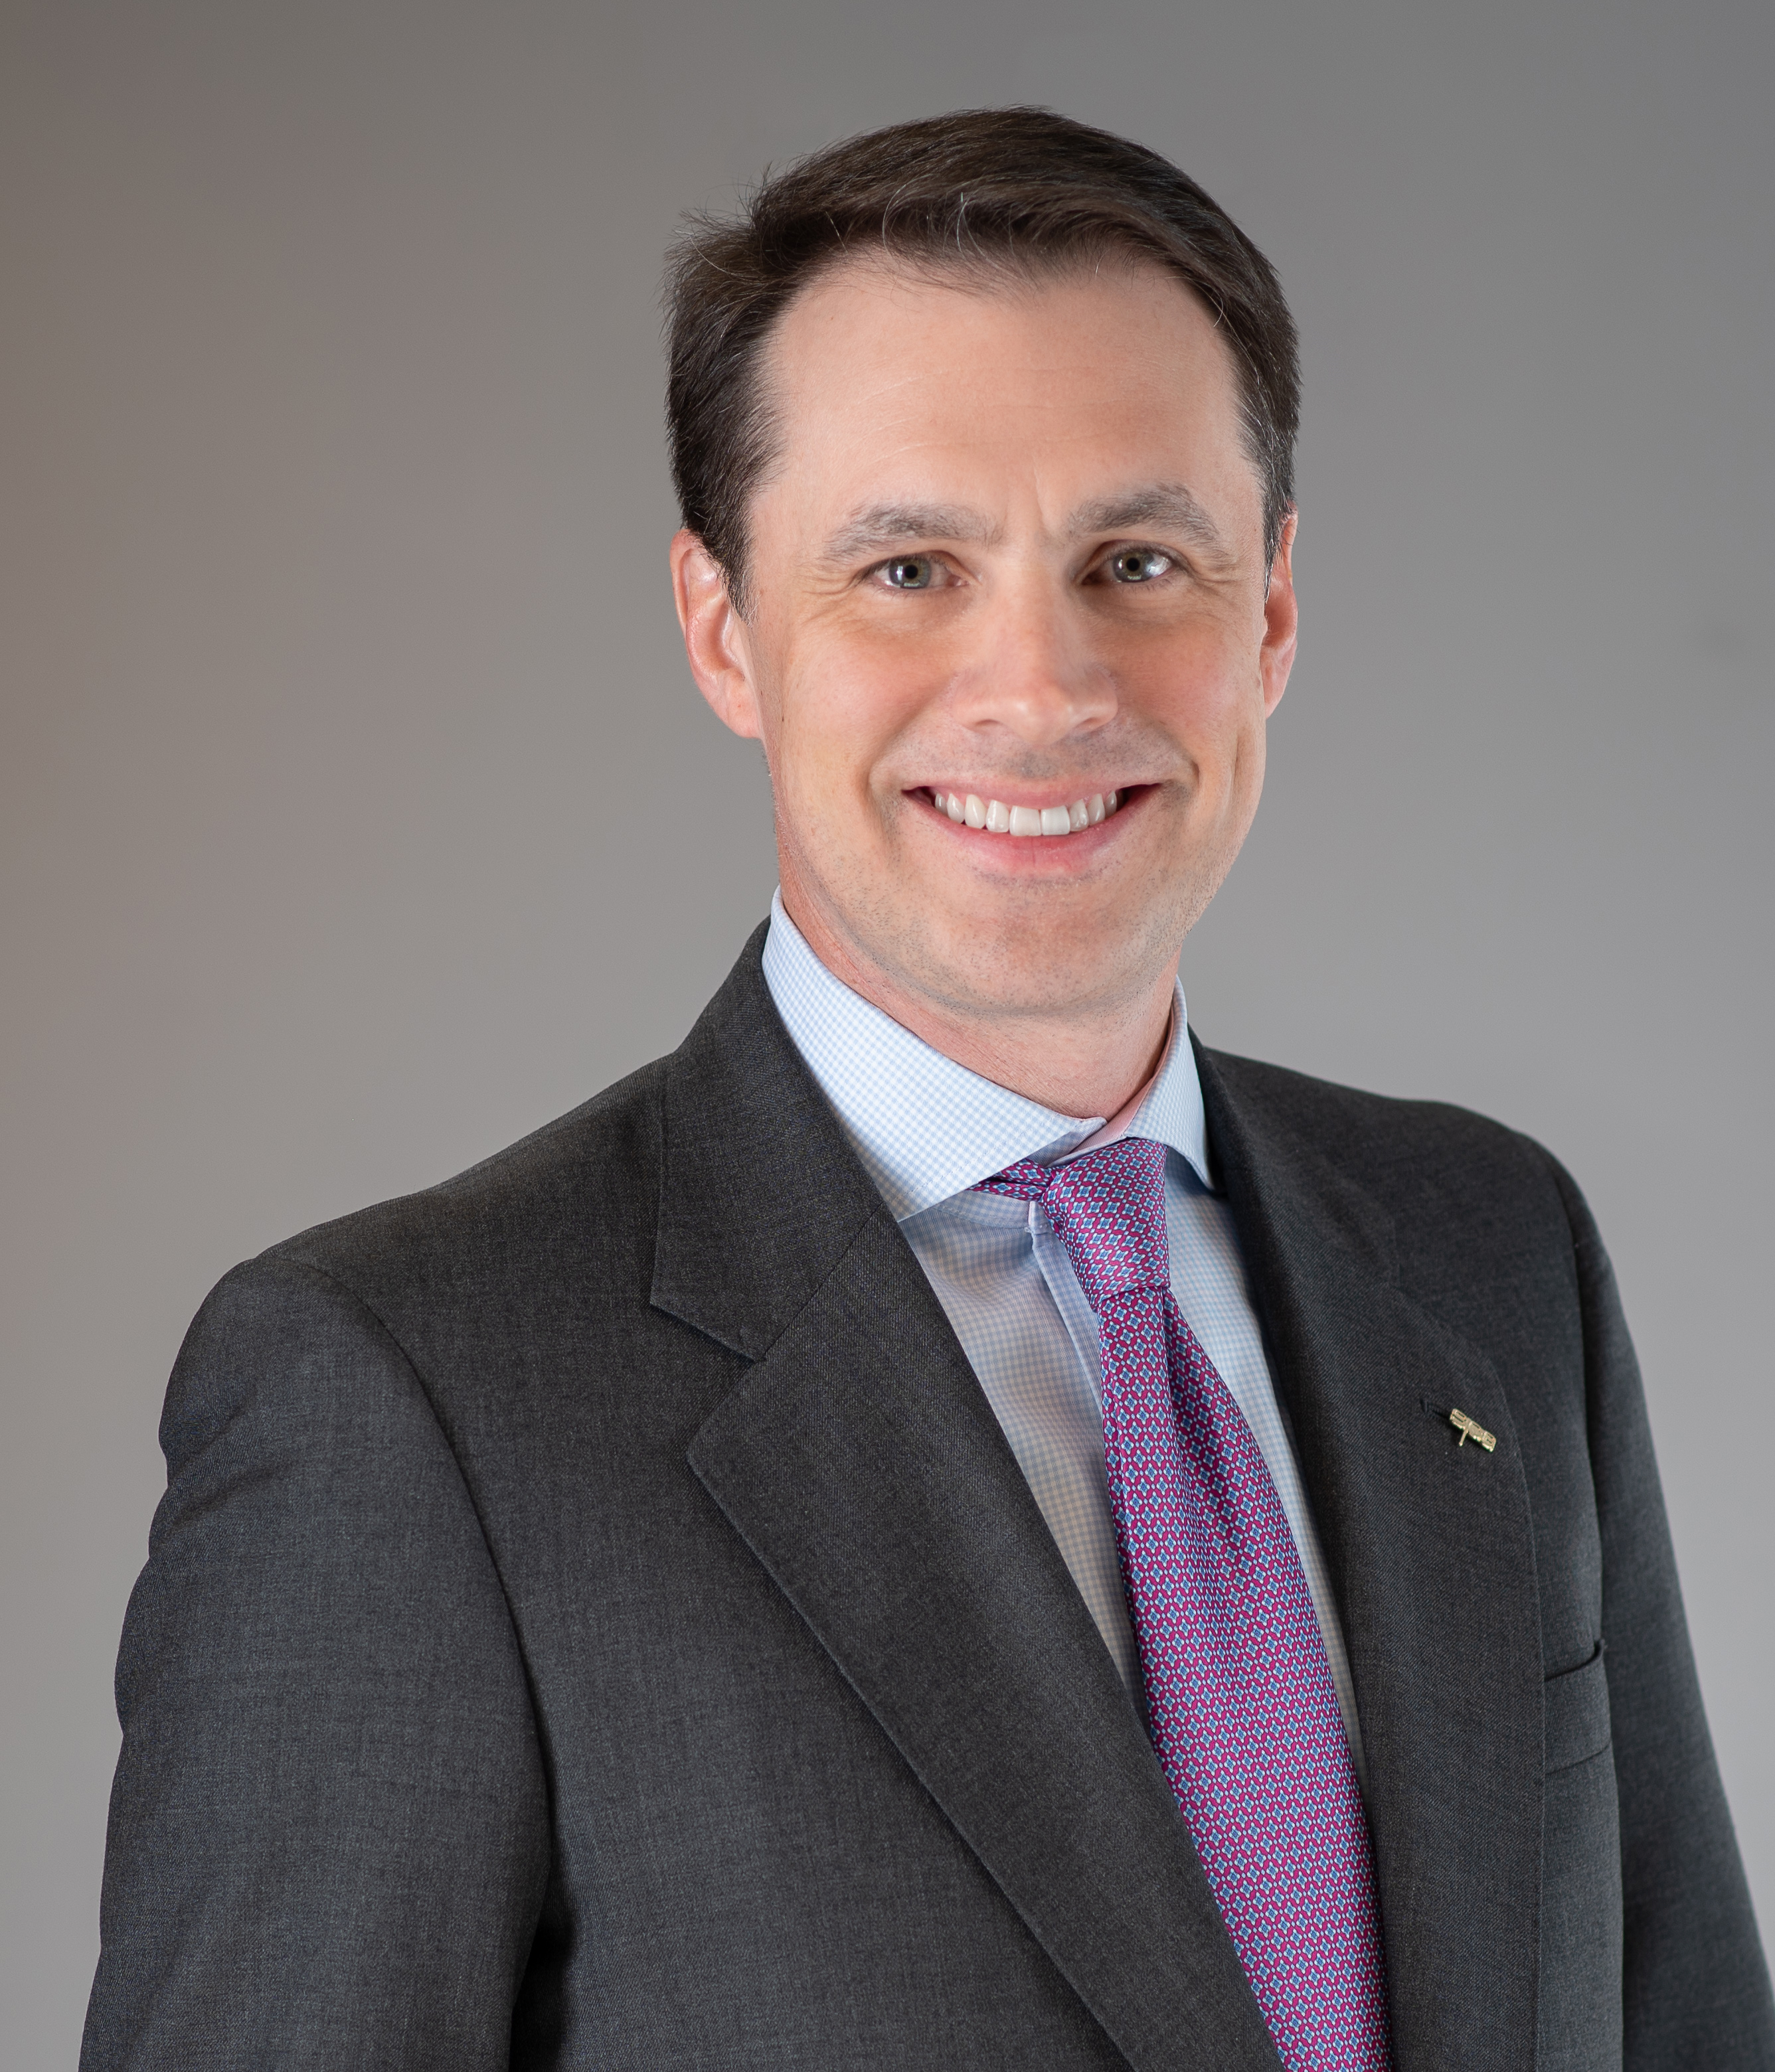
Dan Muse
Systems Planning & Analysis CFO
Began career as public accountant at Arthur Andersen
Spent 11 years at Stifel as an investment banker focused on sell-side M&A and capital raising for government services companies
Transitioned to CFO roles at
    Sevatec, a founder-run business that doubled from $50 million to $100 million during two-year tenure
    FCI, a 40-year-old company that had just been acquired by small private equity, heavily levered with significant contract concentration
    Solerity (formerly Preferred Systems Solutions or PSS), owed by CM Equity, a small/mid PE firm solely focused on GovCon
    Iron Bow, a value-added reseller owned by HIG Capital with 1,000 employees and $1.5 billion in revenue
  Earlie this year became CFO at SPA, an Arlington Capital portfolio company with nearly 2,000 employees and $500 million in revenue
Hold a B.S. in Accounting & Finance from University of Richmond and an MBA from Tuck School of Business at Dartmouth College. Earned CPA and CFA® designations
Reside in Bethesda, MD with wife Kate Troendle (investment banker at KippsDesanto) and an avid golfer!

Slide 8
Becoming a CFO….
There is no single path to the CFO role!
Vast majority of CFOs grow up within accounting/CPA or finance/M&A tracks
  Need to punch a certain number of tickets, but not necessarily all of them. Depends on size of company and budgets.
Mastery, Urgency and Specificity; Precision of Language
Executive Presence; Primary executive who translates strategy/vision into tactics, a consistent sales personality to the external world
Some OCD helps a lot
Notes:
Rich leads a general overview of “becoming a CFO”

Slide 9
Not All CFOs are Created Equal
“Glorified Controllers”
Traditional CFOs (…ownership over finance/accounting, but limited operational or technical insights into the business)
Standard CFOs (…increased operational insight and ownership of additional areas such as IT or HR)
Operational CFOs (…perform all CFO duties, along with acting as the de facto COO; true partner to the CEO;
this is the goal)
…some differences within owner-led, PE-backed and Public companies
Notes:
Give quick overview of the different types of CFOs and lay groundwork of how we are going to focus on working to become an Operational CFO

Slide 10
New CFO Experiences
Anyone feel like an imposter?
Where to start?
What do you spend your first few weeks doing?
How do you prioritize responsibilities and initiatives?
How do you develop relationships with your team, your CEO, and key executive leaders throughout of the company?
Imposter Syndrome: Fear of being found out
Growth Mindset: Seeking out what you need to know to fill the knowledge gaps
Explosion of Responsibility happens with you become a CFO
Notes:
Dan/Rich ask for several examples from current/new CFOs on their first role and how they felt, what they did.
End with Dan briefly describing his first week as a CFO and asking Rich to lunch (while switching to next slide)

Slide 11
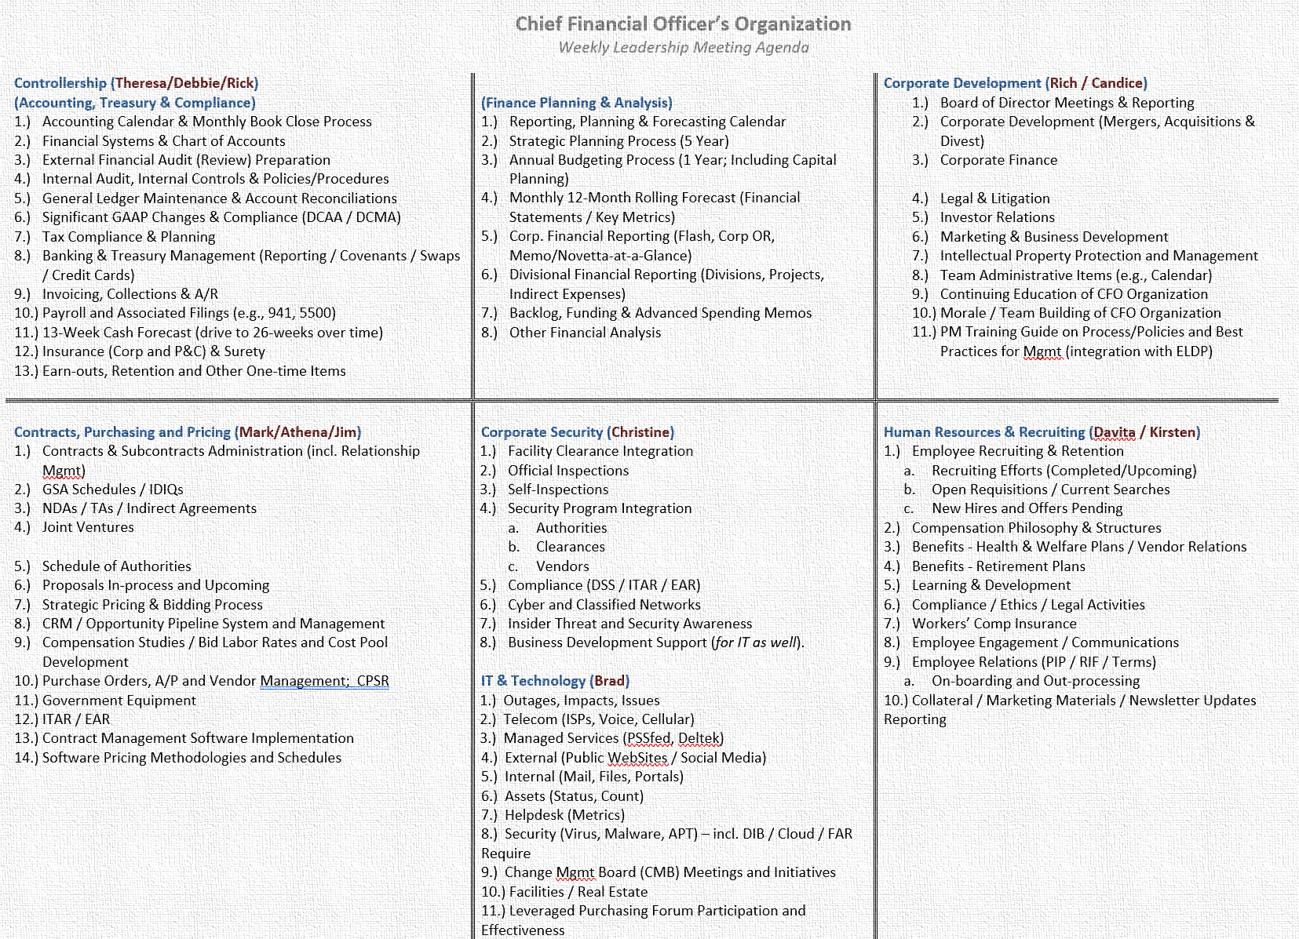
Dan’s First CFO Role – Week 1
Circa 2015
“Phone a friend”
Organize areas of responsibility
There are no dumb questions…
…at least not if asking the right person
Remember to focus on why you were hired – what did the CEO/Board see in you and want you to achieve

Slide 12
CFO are Responsible for Three Primary Areas
Installing controls and protecting the assets of the company (physical, intellectual and human)
Providing analysis of and insight into financial performance and operational objectives of the company
Share operational control with the executive team to ensure the achievement of the strategic plan of the company
Compliance & Recommendations → Co-Operating the Business

Slide 13
Master the Core Roles First
Controllership
Finance
Corp. Development
Accounting Policies
Financial System / Chart of Accounts
Monthly Close
Audit (Financial vs. DCAA/DCMA)
Taxes (Income, S&U, BPOL)
Treasury Management
Fixed Asset Management
Lender Reporting
Budgeting
Forecasting
Financial Analysis
Program Control
Board Reporting
Operating Reviews
Investor Relations (Capitalization Table Management)
Strategic Planning
Acquisitions
Divestitures
Fund Raising & Financing
Liquidity Planning & Process
These are the “must haves” for any CFO
Exact composition of core roles may vary slightly based on company size, ownership structure, etc.

Slide 14
Determine What Roles to Add Next
Contracts & Pricing
Legal & Compliance
Facilities
Contracts
Subcontracts
Purchasing & Procurement
Document Retention
Pricing
Proposal Support
Policies
Export Control (ITAR / EAR)
Insurances & Risk Management
Business Continuity Planning
General Counsel (or liaison to outside counsel)
Secretary to Board
Real Estate Portfolio Evaluation
Lease Optimization
Physical Security
Office Policies
Negotiations of New Leases, Extensions, Subleases, etc.
ESG
These areas tend to be adjacent to core CFO organization and are common areas for CFO oversight

Slide 15
Determine What Roles to Add Next (cont.)
HR & Recruiting
IT
Security
Employee Care
Comp Philosophies & Payroll (incl. bonuses)
Benefits & Wellness
Retirement & 401(k)
Performance Management
Communications
Compliance & Filings
DEI
Talent Acquisition
Training & Development
Info Management
Networks
Communications (telecom, video, email)
Desktop & Device Management
Cybersecurity (CMMC)
Classified Systems
Websites
Helpdesk
Ops vs. Dev vs. Infra vs. External
Facilities (FCL)
Personnel
Systems
Insider Threat
Federal vs. Commercial vs. International
CFO may oversee these areas – largely depends on company size, structure and capabilities of other managers
Don’t need to know everything but need to know what questions to ask!

Slide 16
CFO Organization Examples
$100M
Founder-Owned/Led
$40M
Small PE
$250-500M
Midsize PE
$1.5B
Large PE or Public
Each company structure is unique and org charts are often the result of individual leader’s strengths and weaknesses
Smaller companies may mean CFO has greater span of control versus larger companies with more executive leadership
Accounting
(4)
Accounting
(2)
Accounting
(~15-20)
Accounting, Collections, Credit (34)
Finance / Project Control (3-4)
Finance / Project Control (2)
Finance / Proj Control
(~20-25)
Finance, Treasury, PC, Biz Ops (19)
Human Resources (3)
Human Resources
(1-2)
35-45 FTEs
Order Management
(50)
Corp Dev
(1)
Recruiting (4)
Recruiting
(1-2)
Facilities
(3)
IT (2)
IT
(Outsourced)
105 FTEs
Contracts (added later)
(3)
Contracts
(1-2)
16-20 FTEs
Facilities & Security
(1)
9-11 FTEs

Slide 17
Break-out Session
Company Attributes (welcome to the team)….
Let’s discuss….
Groups of 8 or so
15 minutes
You’ve just joined become the CFO of a government contractor company that has the following attributes
Where do you focus your time in first 30 days?
What are your high and low priority areas?
Which job would you want?
Not want?
A: $25m Rev | B: $75m Rev | C: $100m Rev | D: $200m Rev
Founder Led | Recently acquired by PE | Founder Led with minority PE investment | PE owner who is very active in sector (18 mo in)
Nearly all SB set-aside, beginning transition to F&O | Still some SB contracts | Looking to make company’s first acquisition | Acquired 2 add-ons since PE investment
No Debt | 2-3x leverage | No debt | Highly levered
Great reputation at key customer | Looking to acquire | Major recompete on the horizon | Aggressively seeking more acquisitions
Small back-office staff | Relatively new CEO | High profile board members | Well-known, high functioning CEO
Owner wants to continue growth | Long tenured staff | Business outgrew back-office | Desire to increase margins through IP
2 of founders family members work in business | Significant backlog but flat growth | Provides mid-level services | PE owner very demanding

Slide 18
Choosing the Company that Fits You Best
Finding the ideal role can take time and some trial and error
Bigger is not always better
Short-term compensation, long-term compensation, career goals, quality of life, etc. all need to be evaluated
Publicly Traded
Ownership Structure
Industry, Role, Partners, Money
Funded (VC or PE)
Founder / Family Led
Small
Medium
Large
Business Size

Slide 19
CFO Role Continues to Evolve
Most CFO used to be glorified controllers
Increased financial complexity (PE ownership, greater leverage, etc.) have helped to elevate role of CFO
Government contracting also requires CFOs with broad skills to understand pricing, indirect rates, FAR, M&A, CMMC, and more
Many companies have a bifurcated executive structure:
  CEO is face of company to current & potential customers
  CFO is face of the company to rest of the market (partners, lenders, etc.)

Slide 20
Excerpts from Articles on the Changing
Role of the CFO
“Many CFOs a decade ago were probably great ‘stewards’ but saw the business more through an accounting lens versus a strategy and value-creation lens”
“C-level executive have more in common with their executive peers than they do with the people in the function they run”
…the modern CFO is the linchpin of an organization’s strategy, a bastion of risk management, and the often-overlooked soul of corporate culture.
In a world often reduced to spreadsheets and quarterly reports, the CFO is a translator, transforming numbers into narratives that matter to people.
This isn’t about having a sixth sense or a crystal ball but a grasp of data, trends, and a fair bit of ‘gut feeling’
Entrepreneur, October 2023
Once people reach the C-suite, technical and functional expertise matters less than leadership skills and a strong grasp of business fundamentals.
…members of senior management are expected not only to support the CEO on business strategies but also to offer their own insights and contribute to key decisions.
The top finance job demands a far broader background than it used to. CFOs now need experience with capital markets, mergers, and information technologies…CFOs are asked to play a more active role in managing external stakeholders and…[are] also expected to have experience in operations and other corporate functional areas
Harvard Business Review, March 2011
CFO role continues to evolve as technology and society changes

Slide 21
Latest Challenges Facing CFOs
Extremely tight labor market and turnover
Rising interest rate environment
Political dysfunction
Geopolitical events
Diversity, Equity, and Inclusion (DE&I)
Fewer COOs
Greater responsibility in a cost constrained environment
Global economics and politics

Slide 22
Okay…So how do you get there?
Requires sacrifices
  Networking to build and maintain relationships within and outside of company (industry partners, other CFOs, service providers, etc.)
  Extra hours – “doing stuff” may be pushed to evenings or weekends since “working hours” are used more for leading and learning
Focus time and attention on areas of less knowledge, avoid temptation to default into comfort zones
Delegate and manage work to create time to focus on critical areas
There is no single playbook for becoming and succeeding as a CFO!
Strategic Initiatives
Resolving Issues
Recurring Tasks
Doing
Managing
Leading & Influencing

Slide 23
Thank You
Any Questions??

