Slide 1
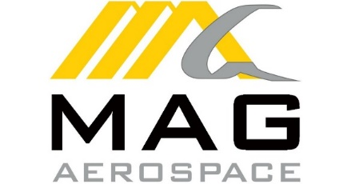

Sources of Capital | August [__], 2021

Slide 2
Welcome Back!
SESSION 1
Program Introduction
SESSION 2
Budgeting, Forecasting & Financial Reporting
SESSION 3
What do we want from a CFO?
SESSION 4
Capital Sources, Debt & Equity
SESSION 5
Audit & Tax
SESSION 6
Executive Leadership
SESSION 7
Indirect Rates & Pricing Strategy
SESSION 8
Buy & Sell Side M&A
SESSION 9
Communication, Team Building & Accountability
SESSION 10
CFO Oversight Areas & Continuing Education
SESSION 11
Strategy
SESSION 12
Program Recap-Capstone
Notes:
To be briefed by the MC.

Slide 3
Sources of Capital
Notes:
-expand or shorten width of orange box for even spacing on all sides of Section Title text

Slide 4
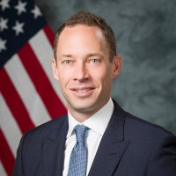
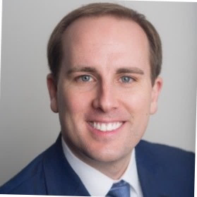












Presenters
Nick Veasey
MAG Aerospace,
Chief Financial Officer
Ellis Chaplin
Raymond James,
Director
Experience
Education

Slide 5
Agenda: Sources of Capital
Equity
Debt

Slide 6
Why this matters to you as a CFO
Understand the reason for each capital source
Understand the pros and cons of each capital source
Learn from real life case studies

Slide 7
Equity
Section 1:

Slide 8
Equity
Public:
Initial Public Offering (“IPO”)
Special Purpose Acquisition Company (“SPAC”)
Private:
Employee Stock Ownership Plan (“ESOP”)
Majority Investment
Minority Investment

Slide 9
Public - IPO
IPO volume by year
Definition: a public offering in which shares of a company are sold to institutional investors and retail investors through the primary market.
Number of offerings by market cap
LTM IPO volume by sector ($B)
Source: Dealogic as of 08/15/21
Note: Data includes SEC registered, rank eligible, U.S. marketed IPOs raising over $25M; excludes closed-end funds.

Slide 10
IPO: Recent Market Trends
Commentary
Several factors driving increase in withdrawn IPOs
  Amount of offerings withdrawn was stable before seeing a major spike beginning in mid July
    2021 has seen a record level of IPOs and de-SPACs leading to investor fatigue
    The last month and a half has seen the same amount of IPO offerings withdrawn as the first six months of 2021
  $5.0 billion in IPO value withdrawn in the last month and a half
YTD IPOs withdrawn by month
Source: Dealogic as of 08/15/21
Note: Data includes SEC registered, rank eligible, U.S. marketed IPOs raising over $25M; excludes closed-end funds.

Slide 11

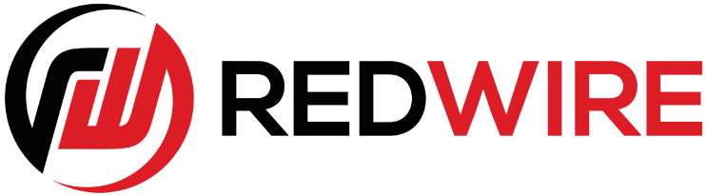
Public - SPAC
Total SPAC IPO issuance ($mm)
$83,353
$121,200
Definition: a shell corporation listed on a stock exchange with the purpose of acquiring a private company, thus making it public without going through the traditional initial public offering process.
Representative GovCon SPAC transactions:
Active SPAC summary
Group | # of SPACs | Amount in Trust
Total Active (Announced & Seeking) | 586 | $175bn
Announced Merger | 147 | $44bn
Seeking Merger | 439 | $131bn
Pre-IPO | 301 | $69bn
Sources: Capital Markets Gateway; Dealogic; and SPAC Research
Data as of 08/15/21

Slide 12
SPAC activity by month 2021YTD
Sources: Dealogic, SPAC Research. Data as of 08/15/21.

Slide 13



Private - ESOP
Notable ESOPs:
Definition: a company's employees own shares in that company. Employees typically acquire shares through a share option plan. Such plans may be selective or all-employee plans. Selective plans are typically only made available to senior executives.
Attractive alternative for shareholders unable to attract other public or private equity

Slide 14




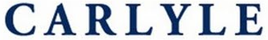


Private - Majority
Full Buyout
Definition: a buyer acquires greater than 50 percent of the stock of a company.
July, 2021
November, 2020
Leveraged Recapitalization
February, 2021
April, 2019

Slide 15


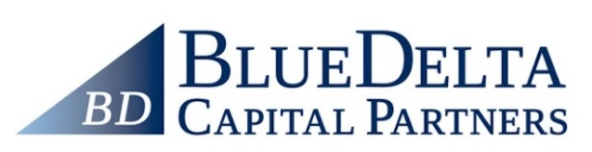

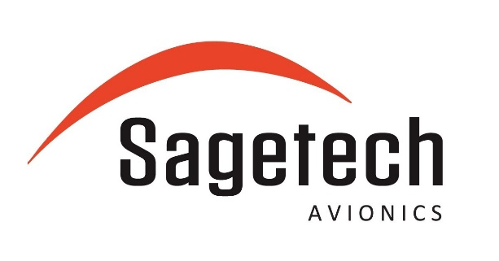

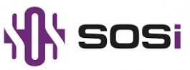
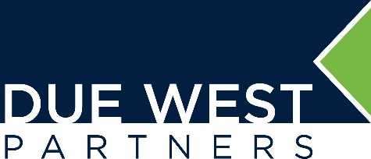
Private - Minority
Definition: a buyer acquires less than 50 percent of the stock of a company.
Has received an investment from
Has received an investment from
Has received an investment from
Has received an investment from

Slide 16
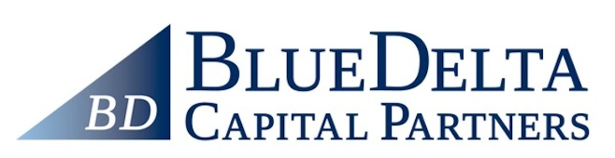


Case Study: METIS Solutions
Has received an investment from
Has acquired
Has been acquired by
Founded
2010
Minority Investment
2016
Bolt-on Acquisition
2019
100% Sale
2020

Slide 17
Debt
Section 2:

Slide 18

The decision to use debt in the capital structure
Financial flexibility
Common Stock
Preferred Stock
The type and amount of debt in a company’s capital structure impacts the following objectives:
Achieving the highest return on equity for existing shareholders
Maintaining sufficient financial and corporate flexibility
Minimizing dilution to existing shareholders and achieving optimal all-in cost of capital
Accessing markets in a timely fashion in order to meet funding requirements
Maintaining a sound capital structure to ensure future access to capital
Convertible Securities
Mezzanine Debt
Senior Notes (Bonds)
Bank Debt
Cost of debt / equity
Ranking of corporate obligations by seniority
Highest Payment Priority Lowest Payment Priority | Taxes owed
 | Bank Debt (secured)
 | Senior Unsecured Notes (Bonds)
 | Subordinated Debt
 | Preferred Stock
Lowest Payment Priority | Common Stock
You don’t need to be the expert – there are plenty of advisors out there – but you do need to understand incentives

Slide 19
Ratings Agencies
Key takeaways:
While there are a few names in our sector with investment grade debt, most companies have high yield debt
High yield debt ratings begin at the “4 B” level
Rating agencies oftentimes take a “worst-case scenario” appraisal of a company’s debt
 | Standard & Poor’s | Moody’s | Meaning
Investment grade | AAA | Aaa | Highest rating assigned. Capacity to pay interest and repay principal is extremely strong
 | AA+ AA AA- | Aa1 Aa2 Aa3
 | A+ A A- | A1 A2 A3
 | BBB+ BBB BBB- | Baa1 Baa2 Baa3
High yield | BB+ BB BB- | Ba1 Ba2 Ba3 | Faces ongoing uncertainties or exposure to adverse business, financial, or economic conditions which could lead to inadequate capacity to meet timely interest and principal payments
 | B+ B B- | B1 B2 B3 | Greater vulnerability to default but currently has the capacity to meet interest payments and principal repayments
 | CCC+ CCC CCC- | Caa1 Caa2 Caa3 | Dependent upon favorable business, financial, and economic conditions to meet timely payment of interest and repayment of principal
 | CC C | Ca C | Subordinated debt of higher rated senior debt issuers or bankruptcy petition will be filed
 | D |  | In default
3
1
1
2
3
2

Slide 20
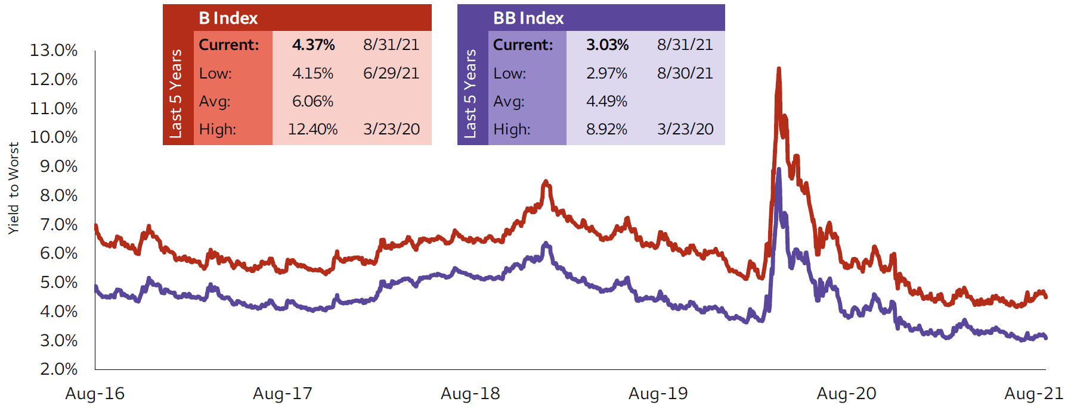
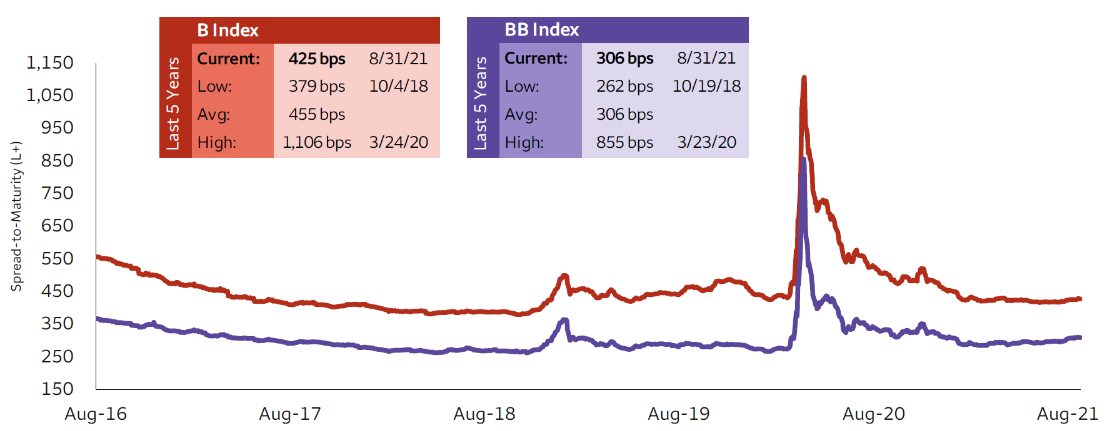
Debt Market Statistics
Senior Notes (Bonds) Pricing – Last 5 years
2
Key takeaways:
In a low interest rate environment, asset managers are hungry for yield which continues to support the high yield debt markets
Covid caused a significant disruption in the debt markets – Single-B high yield bonds were pricing higher than 12%
As the economy began to recover and many companies successfully began working remotely, Bond pricing came down and is now cheaper than pre-pandemic levels, while term loan spreads resemble pre-pandemic norms
1
1
3
2
Term Loan Spreads – Last 5 years
2
3
1
3

Slide 21

Principal Characteristics of different financing options
($ in millions) | Bank debt (Term Loans) | High yield (Junk) Bonds | Mezzanine debt | Convertible securities
Typical size range: | Varies | $150.0–$500.0 | $20.0–$150.0 | Varies
Pricing: | Floating at LIBOR or a Base Rate + an applicable margin, cash interest | Fixed rate (priced off relevant Treasury), cash or non-cash coupon plus warrants | Varies. Floating rate or fixed rate, cash or non-cash coupon plus warrants | Fixed rate (priced off relevant Treasury), cash or non-cash coupon plus conversion rights into common equity
Amortization/ repayment requirements: | Interim payments generally required | None, except at maturity | None, except at maturity | None, except at maturity
Equity dilution: | None | Potentially, depending upon warrant provisions | Potentially, depending upon warrant provisions | Potentially, depending upon conversion rights
Collateral: | Assets and/or stock of subsidiaries | Generally, none | Generally, none | None
Access to capital markets: | Minimal public market awareness | Creates awareness in public capital markets and a benchmark to facilitate subsequent capital raising | No public market awareness | Creates awareness in public capital markets and a benchmark to facilitate subsequent capital raising
Prepayment flexibility: | Generally prepayable at any time | Non-call period generally 4 to 5 years and then subject to a prepayment/call premium | Varies. Typically includes a non-call period or prepayment penalty | Non-call period generally 4 to 5 years and then subject to a prepayment/call premium
Maturity: | 5–9 years | 7–10 years | 6–10 years | 7–10 years
Public disclosure: | No disclosure required if private company | Disclosure required | No disclosure required if private company | No disclosure required if private company
Principal investors: | Commercial Banks, Institutional Funds | CBOs, Mutual Funds, Prime Rate Funds, Hedge Funds | Mezzanine Funds | Equity and Convertible Mutual Funds
5
Key takeaways:
Term loans are floating, bonds are fixed
Term loans require a small amount of annual principal payments, bonds do not
Term loans are collateralized by your assets, bonds aren’t
Term loans are pre-payable, bonds are expensive to pre-pay
Mezz and Converts are complicated, highly flexible and super expensive
1
1
2
2
3
3
4
4
5
Story Time: Public company evolves its capital structure to meet changing ownership and evolving business requirements

Slide 22
Mezzanine Debt
Interest is generally payable in cash at negotiated rates (may be either fixed and variable)
The cash payment rate is usually equivalent to the high end of high yield bond pricing (approximately 12%–13%)
However, investors are provided with a combination of payment-in-kind interest and equity warrants in the company such that their all-in return is targeted between the range of 18%–22%
Ranks junior in the capital structure
Definition: hybrid instrument that acts as expensive debt with an equity-like kicker

Slide 23
Convertible Debt
Convertible Debt is convertible into common stock at a conversion price that is usually approximately 20%–25% above the at issue trading price
Due to the high potential returns afforded by the conversion option, the instrument has a relatively low coupon interest rate (i.e., approximately 4%–6%)
Interest is generally structured to be payable in cash semi-annually at fixed rates
Deeply subordinated in the capital structure
Definition: hybrid instrument that offers relatively inexpensive debt in exchange for potential shareholder equity dilution

Slide 24
Covenants
Why do Lenders need covenants?
Protection against equity holders who may have objectives that are inconsistent with the risk profile that lenders are willing to accept
For example, equity holders may want to:
    add additional debt to fund internal growth or future acquisitions
    pay dividends
    pay themselves consulting or management fees
Covenants help bondholders ensure that equity holders:
    deleverage (or, more accurately, limit the company’s ability to releverage)
    reinvest earnings rather than paying dividends
Definition: Covenants are agreements made between borrowers and lenders assuring the current and future creditworthiness of the borrower
Standard financial covenants
Total Debt / Adj. EBITDA
Net Debt / Adj. EBITDA
Interest Coverage Ratio
Fixed Charge Coverage Ratio
Limitation on Capital Expenditures

Slide 25
Leveraged Buyouts
What are the typical characteristics of a good LBO candidate?
Steady and predictable revenues, earnings and cash flow
Significant available free cash flow (i.e., minimal capital expenditures and working capital requirements)
Strong management team
Leading market share and strong competitive position
Positive industry fundamentals (i.e., low cyclicality) with attractive growth prospects
Viable exit strategy
Opportunities for value creation
  revenue growth
  margin enhancement (i.e., cost reductions and improved revenue composition)
  improved working capital management
  synergies with other portfolio companies
  ability to make add-on acquisitions
Definition: Acquisition of a company by a Private Equity firm (Sponsor) that uses debt to finance a significant portion of the purchase price

Slide 26
Hypothetical LBO
The Equity and Debt topics are nicely tied together in a simple LBO example. Let’s assume:
10% margin business with 10% growth
Acquired for 11x with 7 “turns” of 10% debt
Working capital and capex needs remain constant
  Conversation starter questions:
Outside of better business performance, how could we increase returns for the equity holders?
What happens if the business underperforms? At what point might the company be in trouble?
Sounds like a good return for the PE firm, but how does management participate?
1
2
3
Don’t let the jargon stress you out!

Slide 27

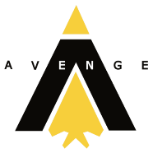

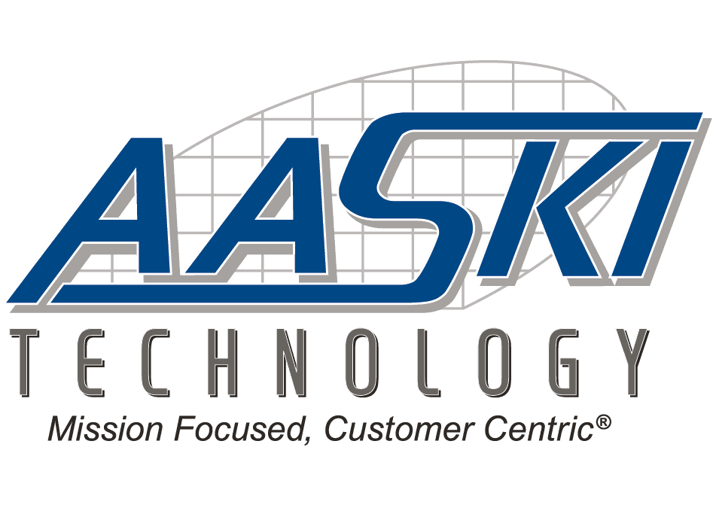






Case Study: MAG
Encore Aviation
Has received an investment from
Has been acquired by
Have been acquired by
Has been acquired by
Founded
2009
Minority Investment
2013
LBO/Recap
2018
Follow-On Acquisitions
2015 – 2020
Transformative Acquisition
2020
Equity
Equity
Debt/Equity
Debt/Equity
Debt/Equity

Slide 28

Questions?

