Slide 1
Session 6| NOVEMBER 10, 2021
Notes:
1st Addressable Slide to get started. To be briefed by the MC.

Slide 2
Executive Leadership – November 10, 2021
Event | Schedule
Arrival & Networking | 5:30PM – 6:00PM
Opening Remarks | 6:00PM – 6:15PM
Panel Discussion and Q&A | 6:15PM – 8:30PM
Notes:
To be briefed by the MC, then turning over to the Presenter of the Evening.

Slide 3
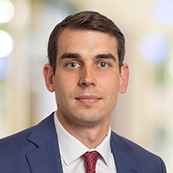
What are our Members up to?
Pearce Lantzy
BlueHalo
PROMOTION
Promoted to VP of Finance from Director of FP&A and Corporate Development in Aug-21. Pearce now leads FP&A, treasury, revenue recognition, and pricing.
Closed 2 acquisitions in September:
DDES and IAI
Notes:
Mandatory slide of the presenter’s Bio. Presenter to craft as they see fit.

Slide 4
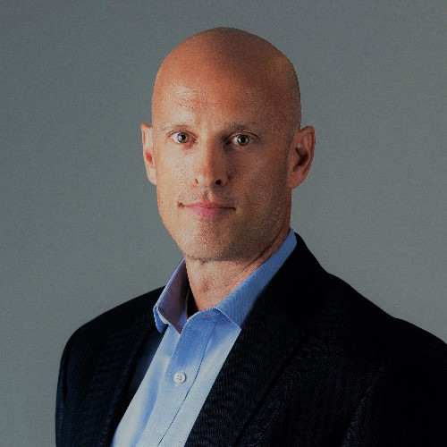
What are our Members up to?
Rick Johnson
Intellibridge
FIRST CFO ROLE!!
IntelliBridge Appoints Rick Johnson as Chief Financial Officer
McLean, Va. – November 4, 2021 – IntelliBridge, a premier partner to homeland security, Federal law enforcement, defense, and civilian agency customers who help solve complex technology, intelligence, and mission support challenges, announced today that it has appointed Rick Johnson to the position of Chief Financial Officer. IntelliBridge is a portfolio company of Enlightenment Capital.
As a trusted financial professional with over 20 years of experience, Rick is a proven leader in developing and managing finance and accounting operations. Rick will leverage his expertise in corporate financial analysis, M&A due diligence and integration, and project lifecycle management to lead IntelliBridge in achieving its financial goals.
Rick most recently served as Vice President of Finance at Novetta, where he was responsible for all aspects of corporate finance, including budgeting, forecasting, buy- and sell-side M&A due diligence, and financial reporting to executive management, the Board of Directors, and other stakeholders of the business. Earlier in his career, Rick successfully led and managed high performing FP&A and project finance teams at Booz Allen Hamilton and BAE Systems.
“We are excited for Rick to join our team,” said Cass Panciocco, CEO of IntelliBridge. “His experience in the Federal government services industry will be invaluable as we continue on our growth trajectory. We have a number of important initiatives underway, which will undoubtedly benefit from his insight and leadership.”
“It is an exciting time to become a part of the IntelliBridge team,” Rick added. “With its strategic partnership with Enlightenment Capital, IntelliBridge has built a solid foundation as a high-growth provider of advanced technologies and mission support to national security customers. I look forward to working with the team to accelerate our growth and continue positioning IntelliBridge for long-term success.”
Notes:
Mandatory slide of the presenter’s Bio. Presenter to craft as they see fit.

Slide 5
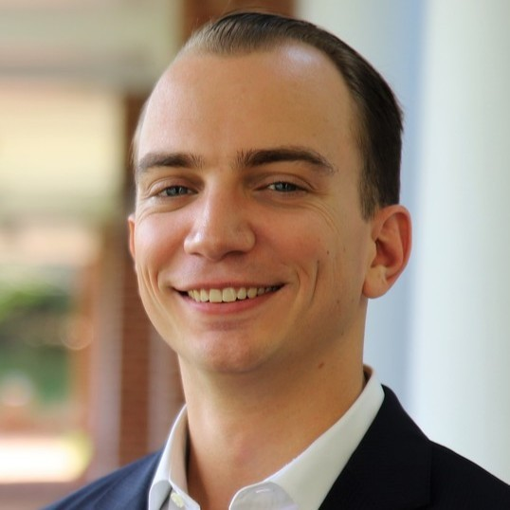
What are our Members up to?
Andrew Bonds
Babylon Micro-Farms
NEW VP OF FINANCE ROLE
Venture backed
Diversity of industry
Building out the finance organization
Notes:
Mandatory slide of the presenter’s Bio. Presenter to craft as they see fit.

Slide 6
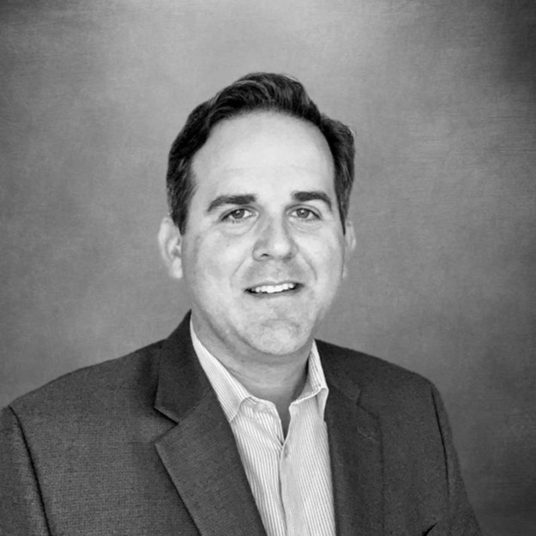
What are our Members up to?
Greg Schaub
HENSOLDT
EXCELLING IN THE CFO ROLE
Poised to achieve all KPI’s
First positive EBITDA year
Working on buy side M&A opportunities
Preparing for Interim Audit
Notes:
Mandatory slide of the presenter’s Bio. Presenter to craft as they see fit.

Slide 7
Introducing Stewart Leadership

Slide 8
Stewart Leadership Building leaders for over 40 years
We help leaders, teams and entire organizations increase effectiveness and drive growth
We focus on the people side of getting to high performance
We design tailored solutions that meet specific client needs
© Stewart Leadership |

Slide 9
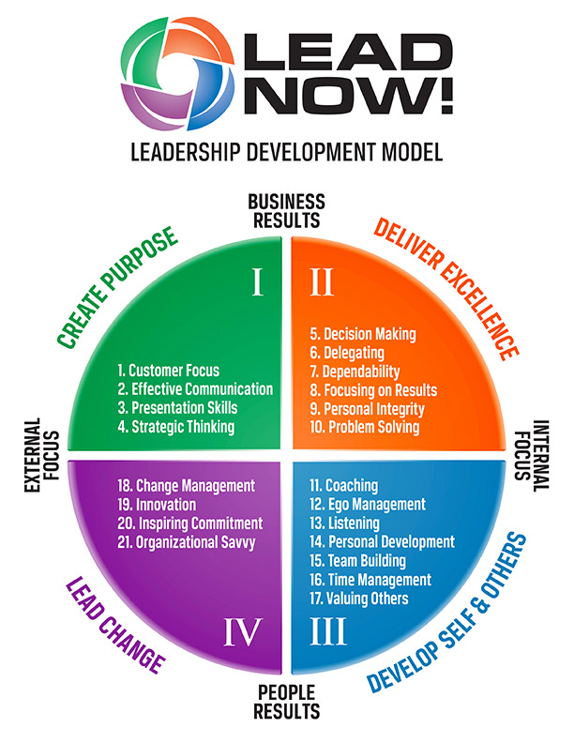

Slide 10
Tonight’s mission
Leadership taught by Leaders, not slides

Slide 11
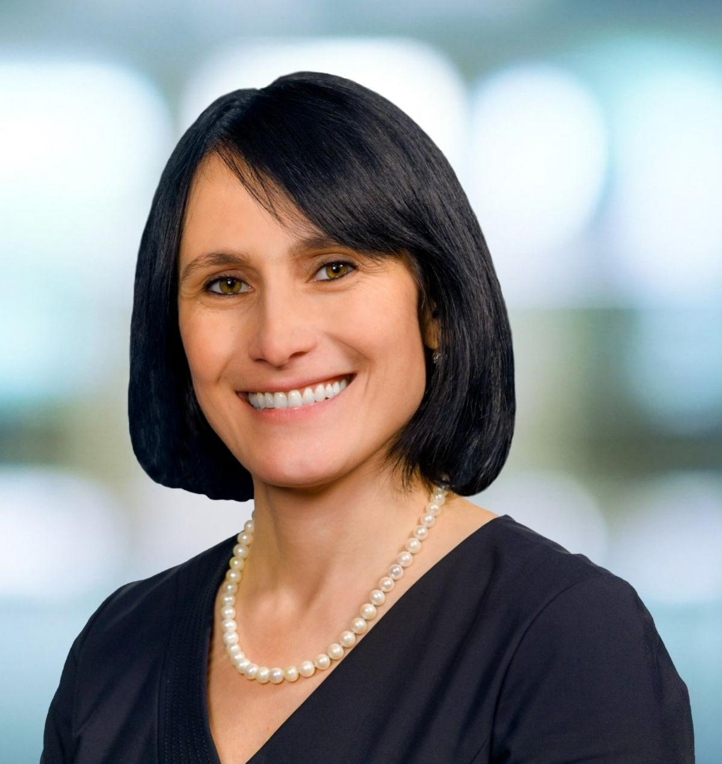
Meet our Panelists
Tamara Jack
Chief Financial Officer- LMI
Tamara leads LMI’s financial and legal operations, including finance and accounting, treasury, tax, enterprise risk management, law department, security and facilities, and pricing. She also serves as corporate secretary and treasurer, overseeing LMI’s external audit and lender relationships. With over 18 years in the defense, technology, and government services sectors, Tamara shapes and executes LMI’s business strategy to drive enterprise value, providing executive leadership in financial strategy & planning and corporate initiatives such as mergers and acquisitions. A director and associate general counsel at LMI from 2005 to 2015, Tamara rejoined the company as chief legal officer and corporate secretary in 2017, adding chief financial officer responsibilities in 2019. Prior to that, she served as vice president, general counsel, and corporate secretary of Blumont, Inc., and served on the board of directors for Blumont’s three subsidiaries. Tamara serves on the board of the Northern Virginia Chamber of Commerce and is the board president for the Association of Corporate Counsel’s National Capital Region
Notes:
Mandatory slide of the presenter’s Bio. Presenter to craft as they see fit.

Slide 12
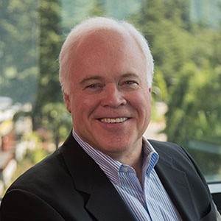
John Parker Stewart
CEO and Founder- Stewart Leadership
John is an award-winning, internationally recognized, and sought-after Executive Development Expert, Leadership Coach, and Team Performance Specialist. He helps senior leadership teams develop and retain exceptional talent while building strong succession planning for the future. Over the past 35 years, John has coached and trained tens of thousands of leaders worldwide and he provides his clients with the tools and coaching they need to be a results-driven leader. John has worked with with organizations such as: Citibank, U.S. Air Force, Chevron, IBM, Lockheed Martin, Toshiba, CSL-Hong Kong, Xerox, GM, Kaiser Permanente, Telstra-Australia, U.S. Dept of Energy, Boeing, and many others.
Notes:
Mandatory slide of the presenter’s Bio. Presenter to craft as they see fit.

Slide 13
What is the trait you most deplore in others? What is your greatest extravagance? What or who is the greatest love of your life? What do you most enjoy in your work?
Our panelists
Getting to know Tamara and John

Slide 14
You just became a CFO. Now what do you do?
Notes:
Mandatory Slide if using a Break.

Slide 15
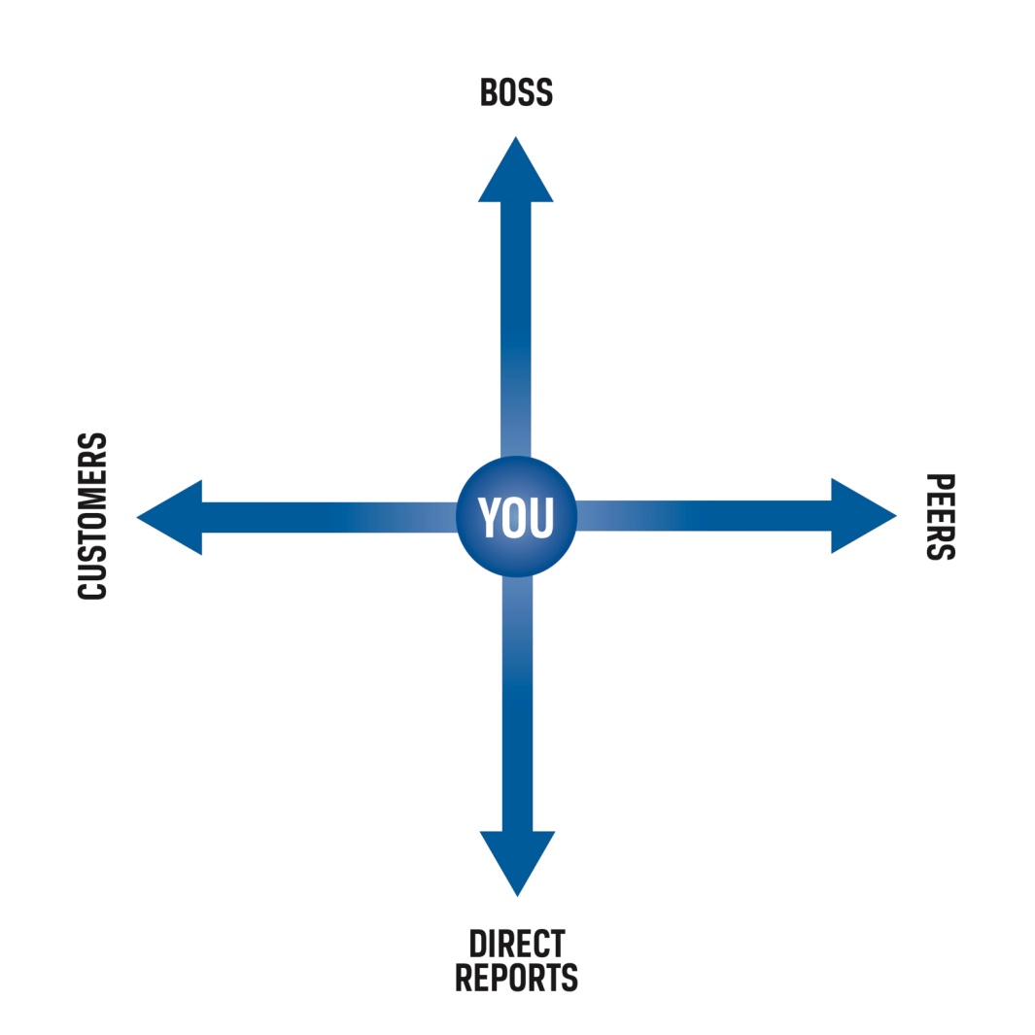
The 4 Key Relationships of a Leader

Slide 16
How does reporting to a CEO differ from reporting to the CFO? What are the Board/Investors expecting of me?
Discussion
Notes:
Mandatory Slide if using a Break.

Slide 17
Focus Area 1: Demanding vs. creating followership

Slide 18
Focus Area 2: Leading without functional experience

Slide 19
Focus Area 3: What’s expected of you?

Slide 20
Focus Area 4: Strategy and Communication

Slide 21
5 Steps For
Sustaining Personal Change
1. Creating Awareness
2. Finding the Desire to Change
3. Developing New Skills
4. Taking Action
5. Building Support Network

Slide 22
Our Journey Ahead
SESSION 1
Program Introduction
SESSION 2
Budgeting, Forecasting & Financial Reporting
SESSION 3
What do we want from a CFO?
SESSION 4
Capital Sources, Debt & Equity
SESSION 5
Audit & Tax
SESSION 6
Executive Leadership
SESSION 7
Indirect Rates & Pricing Strategy
SESSION 8
Buy & Sell Side M&A
SESSION 9
Communication, Team Building & Accountability
SESSION 10
CFO Oversight Areas & Continuing Education
SESSION 11
Strategy
SESSION 12
Program Recap-Capstone

Slide 23
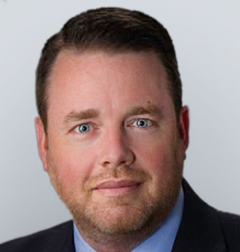
Session 7 – December 15, 2021
Indirect Rates and Pricing Strategy’
Gordon Foster
CFO, Serco North America
Notes:
Mandatory Slide to introduce the next topic/session. To be briefed by the MC.

Slide 24
Mentor Case Study
My first CFO role
Challenges I faced
Things that surprised me
How I succeeded

Slide 25
Mentor Case Study 2
My first CFO role
Challenges I faced
Things that surprised me
How I succeeded

Slide 26
Mentor Case Study 3
My first CFO role
Challenges I faced
Things that surprised me
How I succeeded

