Slide 1

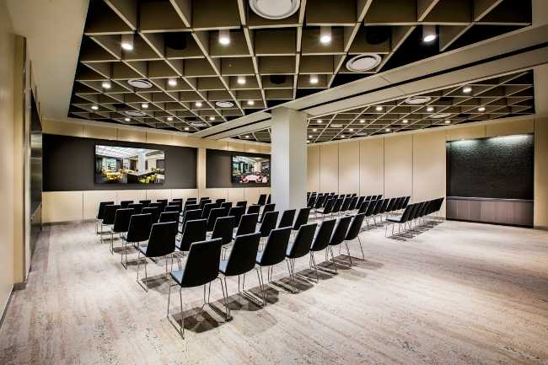
Welcome to Session 2
July 21, 2021
Event | Schedule
Arrival & Networking | 5:30PM – 6:00PM
Main Presentation | 6:00PM – 8:30PM
Wrap-Up & Continuation | 8:30PM +
7900 Westpark Drive McLean,VA
Notes:
‘Splash Page’ to be displayed on screen when guests arrive.

Slide 2
Session 2 | July 21, 2021
© 2021 by CFO Rising - 703-559-4433 | info@cforising.org
Notes:
1st Addressable Slide to get started. To be briefed by the MC.

Slide 3
Welcome Back!
SESSION 1
Program Introduction
SESSION 2
Budgeting, Forecasting & Financial Reporting
SESSION 3
What do we want from a CFO?
SESSION 4
Capital Sources, Debt & Equity
SESSION 5
Audit & Tax
SESSION 6
Executive Leadership
SESSION 7
Indirect Rates & Pricing Strategy
SESSION 8
Buy & Sell Side M&A
SESSION 9
Communication, Team Building & Accountability
SESSION 10
CFO Oversight Areas & Continuing Education
SESSION 11
Strategy
SESSION 12
Program Recap-Capstone
Notes:
To be briefed by the MC.

Slide 4
Opening Remarks
      A few housekeeping and update items:
  Some Updates to Session Format:
    Shooting for a less formal atmosphere
    Using a new seating plan to encourage engagement/networking
    Revised lighting, background music, no podium, more mobile presenting
    Slightly less camera/media engagement to facilitate more open thought
    Added coffee and Miller Lite…
  Be On the Lookout!
    Website Update: Members-Only Portal for Presentation Materials
    Community Chat Platform: Under Development
Looking forward to diving into Session 2!

Slide 5
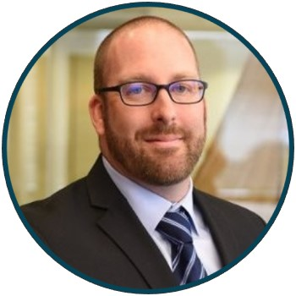
Session 2 – July 21, 2021
Event | Schedule
Arrival & Networking | 5:30PM – 6:00PM
Main Presentation | 6:00PM – 8:30PM
Wrap-Up & Continuation | 8:30PM +
“Before my first sitting P/E CFO gig, mid-2016.
No gray beard yet!”
Tonight’s Presenter
      Jeremy Koczan
        CFO, Smartronix / Trident Technologies
Topic: Budgeting, Forecasting and Financial Reporting
Notes:
To be briefed by the MC, then turning over to the Presenter of the Evening.

Slide 6
Session 2 - Budgeting, Forecasting & Financial Reporting | July 21, 2021
© 2021 by CFO Rising - 703-559-4433 | info@cforising.org
Notes:
1st Addressable Slide briefed by the Evening’s Presenter.

Slide 7

Presenter Bio
      Jeremy Koczan
  ~ 25 Years in Analytical and Financial Management Roles
  Financial Services, Aerospace & Defense (GovCon) Markets
    AM/HS, DoD, FEDCIV, INTL DIR, COM, IC
  Current Role: CFO, Smartronix/Trident (2 Years)
    Cloud MSP, C5ISR, Advanced Engineering and IT
  Prior Roles:
    CFO – Altamira Technologies Corporation (3 Years)
    BU CFO; Analyst – Raytheon Company (10 Roles in 11 Years)
    Analyst Roles for State Street Corp, Precision Castparts Corp (PCC)
    Customer Facing Roles (AMEX, DEC/Compaq/HP, PCC)
  Personal:
    Married, no children, dog dad
    Love outdoors, traveling, music; good cook; decent instrumentalist; terrible/former golfer
    Life Goal: Professional Hiker; CHO – ‘Chief Hiking Officer’
Angela & Wade
Personal Mantra: “Work Smart, Work Hard, Work Fast, Go (or Stay) Home”
11 Moves in 22 Years
Notes:
Mandatory slide of the presenter’s Bio. Presenter to craft as they see fit.

Slide 8




Opening Remarks
  Our goal is to ‘CLIMB’: Coach, Learn, Inform, Mentor, Benefit
  Interaction/contribution is highly encouraged as we’re all victims and benefactors of our experiences
  ‘Experientials and Insights’ will be shared. Have yours ready too!
  Strategies and tactics provided are some of the many ways to enhance the path to success but not the only ways
  Iconography: A different approach to ‘points of order’
= ‘Definition Checkpoints’ for level-setting and nomenclature insights
= ‘Factory Milestones’ Strategies That Have Worked For Me
= ‘CFO Quick Tips’ that you may find interesting/helpful

Slide 9
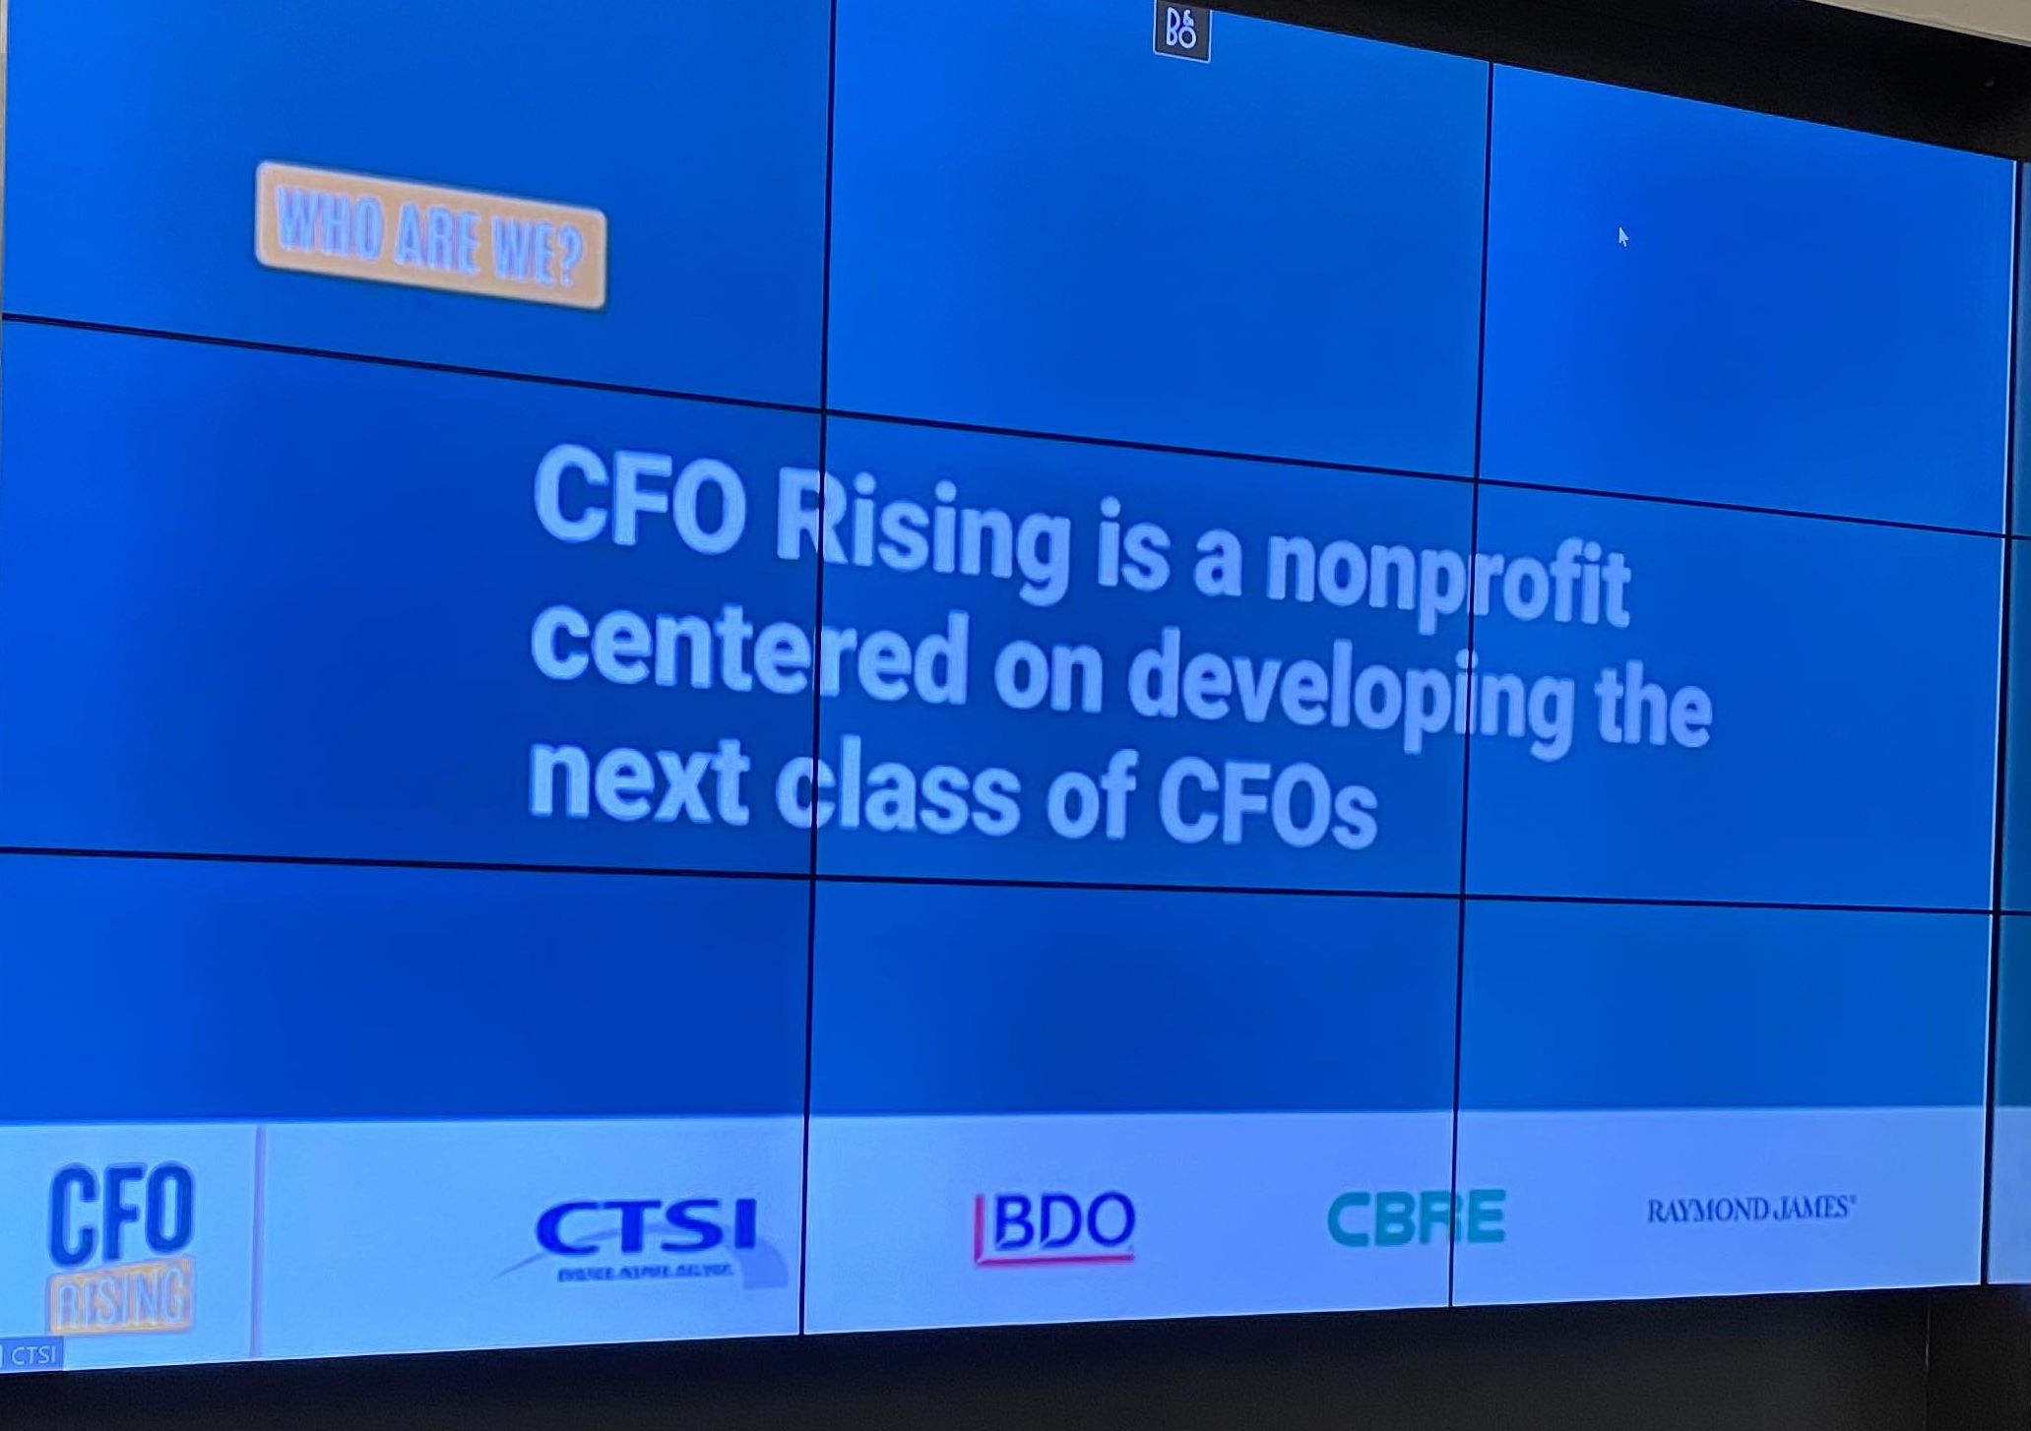
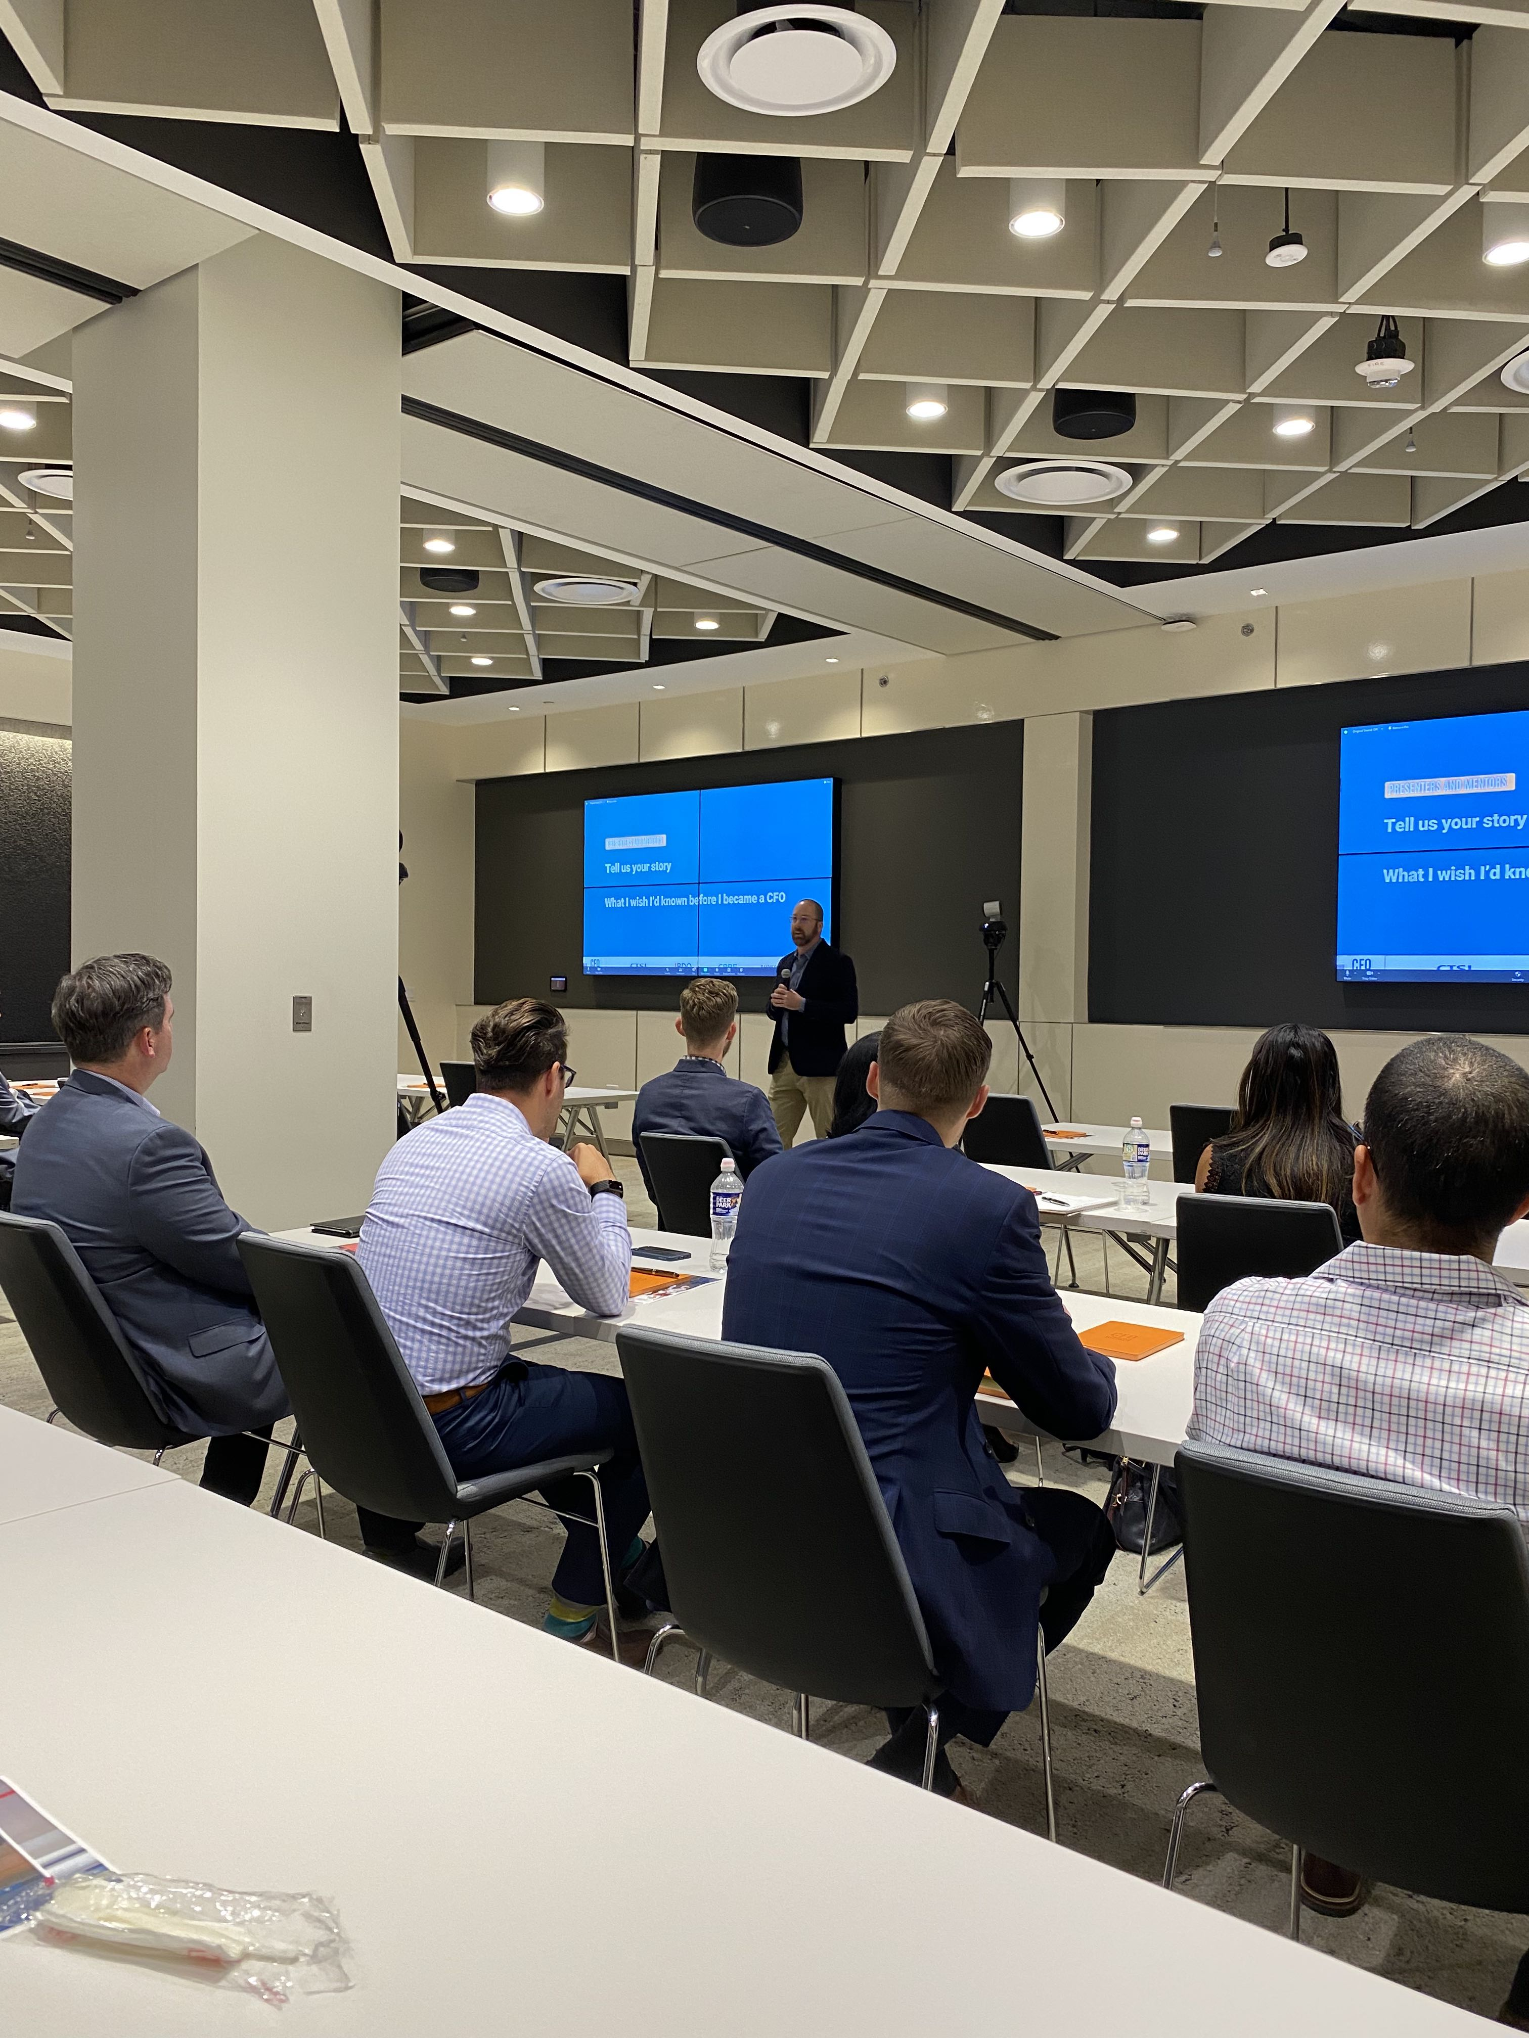
Opening Remarks
      Observations & Themes from Session 1:
  Such an impressive group of financial professionals
  There is no ‘traditional’ path to becoming a CFO
  Members were relieved that they didn’t need ALL the answers
  The strength of these sessions will be defined by people’s willingness to share experiences with a sense of humility and purpose
  Discussion trended more towards people than profits:
    ‘Taking care of your teams, employees, and their families is Priority #1’
This last point is a big departure from CFO trends of the past
Notes:
Consider Story of Broken Down Car.

Slide 10
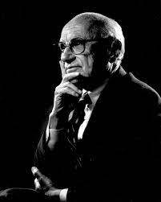
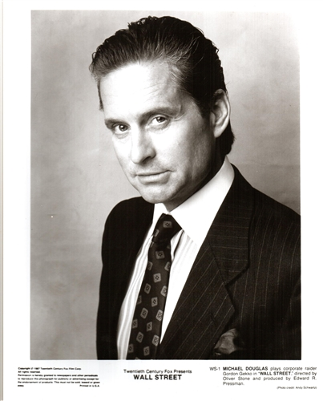
How business thought has shifted
1970’s – 1980’s – ‘The Baseline’
According to Nobel Prize winning economist Milton Friedman, the main purpose of a business ‘is to maximize profits for its owners’. ¹
And in 1987’s cult class film Wall Street, it was said that ‘greed, for lack of a better word, is good’. ²
^{- Gordon Gekko}
“What is the point of business?”

Slide 11
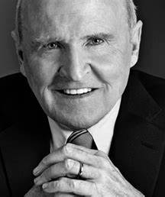

How business thought has shifted
1990’s – 2000’s – ‘The Shift’
Legendary CEO of General Electric Jack Welch once stated that maximizing shareholder value was ‘the dumbest idea in the world’, ³ as prioritizing customers, employees and community would ultimately drive shareholder wealth.
Meanwhile, corporate responsibility guru John Elkington suggested we seek to optimize ‘The Triple Bottom Line’, commonly referring to the optimization of ‘People, Planet, (and) Profit’. ⁴
“What is the point of business?”
Notes:
Add PCC story with LT

Slide 12

How business thought has shifted
Present Day: ‘The Emergence of Purpose’
“Having a strong company purpose — and clearly communicating that to your employees — creates a shared philosophy and culture. Everyone has a part to play in that culture and makes an impact in their individual and unique way. We become an impactful part of something bigger than ourselves.” ⁶
“What is the point of business?”

Slide 13
Combining Past/Present/Future
The ‘4P Pyramid’
People
Profit
Purpose
Planet
The ‘4P Pyramid’ can help senior leaders stay focused on driving value to all stakeholders while simultaneously being a good steward of the business community

Slide 14
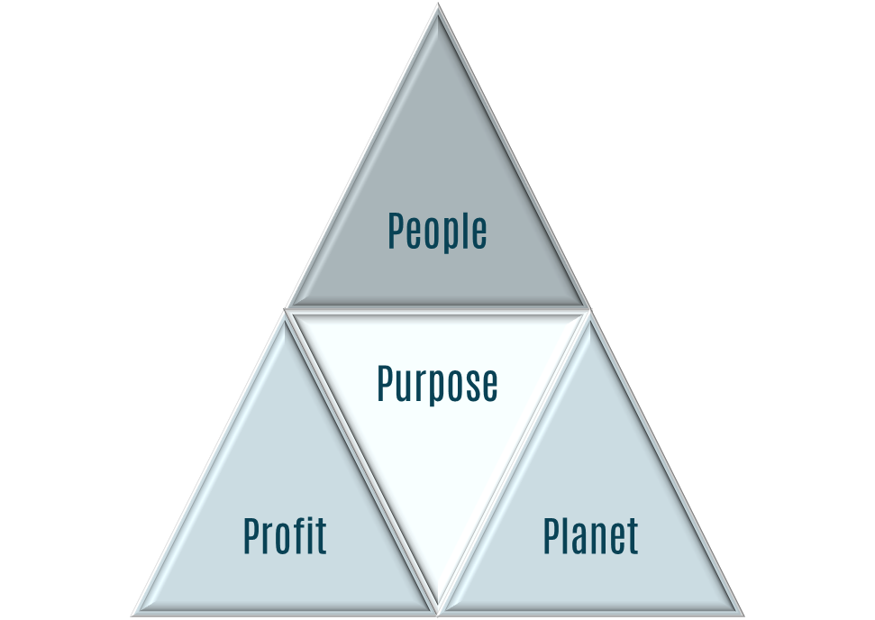
Focus of Today’s Session
Budgeting
Forecasting
FIN-REP
Budgeting, Forecasting, and Financial Reporting can positively impact all elements of the ‘4P Pyramid’

Slide 15
Budgeting, Forecasting, & Financial Reporting
‘Essential elements of a dynamic organization'
‘Essential skills of a CFO’
Topic overview

Slide 16
Definition Checkpoint!
Let’s start with a basic definition of the three topics we’ll cover today:
  Budgeting: ‘the process of calculating how much money you must earn or save during a particular period of time, and of planning how you will spend it’ ⁶
  Forecasting: ‘the job or activity of judging what is likely to happen in the future, based on the information you have now’ ⁷
  Financial Reporting: ‘information that businesses give about their financial situation, including the profit or loss for a particular period, or the process of giving this information’ ⁸
Now, we’ll translate these items into a Business/GovCon perspective

Slide 17
Definition Checkpoint!
From a GovCon Perspective:
  Budgeting: Typically handled by creation of an Annual Operating Plan (AOP).
    The AOP is the detailed/original financial baseline plan for the year, time-phased by month. It is typically created at the FTE/Program/Project/Pursuit Level and provides the financial goals for the year. Once established and approved, the AOP stays the same for the duration of the performance year. (It is derived from the 3/5 Year Strategic Plan; which will be discussed later).
  Forecasting: Typically starts with the AOP, which is then updated each month as actual results are determined.
    The forecast then incorporates the latest revised estimates (LRE) and expectations of business performance for the balance of the year. The forecast is often bounded by ‘Risks & Opportunities’ (R&Os) to establish a High/Low Case outlook.

Slide 18
Definition Checkpoint!
From a GovCon Perspective:
  Financial Reporting: Typically references the suite of financial reports and models that facilitate proper analysis and tracking of business performance.
  Examples:
    Financial Statements: Income Statement, Balance Sheet, Cash Flow Statement
    Major Deliverables: Monthly Operating Review (MOR), Board Reporting
    Additional Reporting:
Reports ( Group A) | Reports ( Group B)
3/5 Year Strategic Plan | Estimates at Completion (EAC)
Annual Operating Plans (AOP) | Project Status Report (PSR)
Monthly Financial Forecast | Labor Utilization Reporting
Monthly Flash Report | Indirect Rate Reporting
Monthly Financial Reporting Model | Wrap Rate Analysis and Reporting
Pipeline and Growth Metric Reporting | Risks and Opportunities (R&Os) Reporting
Bookings/Backlog Reporting | Daily/Weekly Cash Reporting
The bold items will be discussed in today’s session.

Slide 19
Typical Use Cases
Company Size/Stage | Small/Early Stage | Medium/Mid Stage | Large/Mature Stage
Financial Reporting | Always | Always | Always
Budgeting/Planning | Sometimes | Always | Always
Forecasting | Atypical | Typical | Always
    Nearly all companies conduct some form of financial reporting
    Most companies realize they can’t adequately scale if they don’t have a plan
    Eventually, companies conduct all three exercises to align the organization to a common goal, measure performance to that objective, and incentivize the ‘right’ behaviors to accomplish the growth expectations.

Slide 20
Who Owns the Process?
Company Size/Stage | Primary | Secondary | Approval Level
Financial Reporting | Accounting | FP&A | ELT/BOD
Budgeting/Planning | FP&A; Programs | ELT/Functions | BOD
Forecasting | FP&A; Programs | ELT/Functions | BOD
    Accounting maintains ‘past to present’ (aka ‘Actuals’) reporting and analysis.
    Financial Planning & Analysis (FP&A) manages the budgeting, forecasting, and modeling processes with insights and engagement from BU Leads, Program Managers, Program Finance, and Functional Leadership.
    The most mature companies involve all functions in these processes including HR, IT, SCM, Contracts, Legal, Facilities, and others to ensure the most accurate and complete perspective is known.
“Strive to achieve mastery, specific, and urgency in all aspects of your areas of responsibility.” P. LaMontagne, CEO Smartronix

Slide 21
What are the key benefits?
Financial Reporting
Measures Progress and Facilitates Compliance
Budgeting/Planning
Aligns the organization to a common goal
Forecasting
Allows for improved insights and analysis into real-time tracking of business performance and results
Improves investment decision-making and timing of capital deployment
Improves Communication of Business Results
Enhances Cash/Debt Management Effectiveness
Improves Liability Insights and Identifies Business Trends
Provides Tax Reporting Basis
Ensure adequate Stakeholder COMMS and Reporting
Improves Decision-Making
Increases Management Accountability
Ensures tactical actions align to strategic endeavors
Ensures adequate working capital is available
Provides a basis for Incentive Comp Planning
Focuses the organization on cost efficiencies and ‘profit mindedness’
Contributes to revenue/profit analysis and ‘course correction’
Facilitates risk management and opportunity capture
Provides guidance and financial outlooks to key stakeholders
  Reference Notes: Financial Reporting ⁹ ; Budgeting/Planning ^{10, 11} ; Forecasting ¹²

Slide 22
Who Benefits?
Stakeholders
Owners & Investors
Executive Team
Middle Management
Employees
Lenders/Banks
Board
Customers
Budgeting
Forecasting
FIN-REP
“You have to be the arbiter of truth. The CFO makes it real.” An Unnamed Board Member

Slide 23
‘The CFO Role Is The Command Center’
CFO
Owners & Investors
Executive Team
Middle Management
Employees
Lenders/Banks
Board
Customers
Budgeting
Forecasting
FIN-REP
“Good CFOs connect the dots. Great CFOs connect the people.” J. Koczan

Slide 24
‘Develop the Plan’
‘Align the Organization’
budgeting

Slide 25
Planning Process Overview
The Financial Planning Process
The ‘Financial Planning Process’ typically includes a 3- or 5- year plan, which facilitates development of an Annual Operating Plan (AOP), which then becomes the basis for a monthly time-phased forecast.
Monthly financial progress reporting allows for faster reactions to business risks and helps drive responsibility and accountability of the management team.
3/5 Yr Strategic Plan
Annual Operating Plan
Progress/Financial Reporting
Monthly Financial Forecast & Reporting to Monitor/Drive Results
1st Yr of SP = AOP
AOP = Forecast Baseline

Slide 26
Strategic Planning: The Start of the Process
The development of a 3- or 5-year plan is typically the first step in developing the Budget/AOP:
  The Strategic Plan should seek to define:
  Where are we today and where are we going?
  Why are we going there?
  How will we get there?
  How long will it take?
  How will we know when we get there?
Key Elements:
Purpose: Establishes a multi-year strategic framework to define/align enterprise-wide goals and objectives. Yr 1 becomes basis for the AOP
Approach:
  ‘Tops Down’ Baseline Objectives aligned to Key Initiatives, Investment/Resource Focus, Market/Industry Overlay, Organic + Inorganic
  Harvard Business School (HBS) Vision-Mission-BHAG (lite version)
Key Contributors: ELT, Outside Advisors plus Board Review
Deliverables:
    Summary Deck and Associated Back-up
    “What/If” Excel Model
Timeline:
September: CEO-Excel Model, Strategic ELT Sessions; October: 1st Draft; November/December: BOD Review

Slide 27
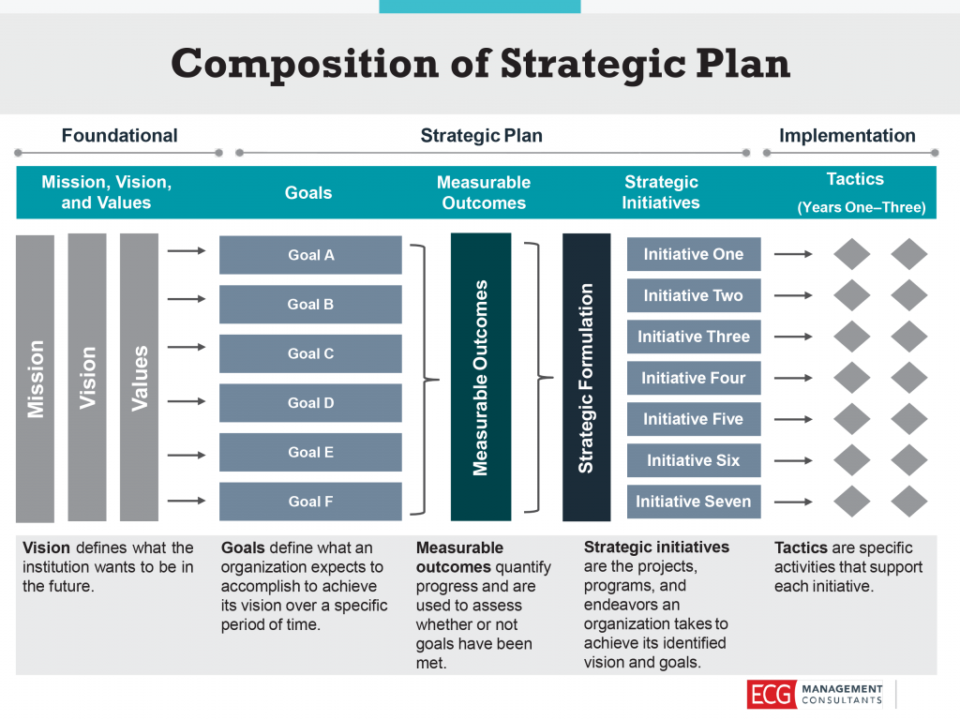
Strategic Plan Framework
Example Framework:
The development of the strategic plan is often governed by a company-specific framework or process guide.
Source: compstratplan-1024x768.png (1024×768) (uic.edu)
Credit: ECG Management Consultants

Slide 28
Setting the Strategic Plan:
The first year of the strategic plan should ultimately inform the AOP development:
Key Elements:
Purpose: To establish and align operational objectives to near term growth and execution initiatives
Approach:
  ‘Bottoms Up’ and exceptionally (or at least ‘especially’) detailed
  ‘FTE’s & ODCs’, Bookings/Revenue/Profit Focus, ‘Backlog Burn’ + ‘New Business Ingest’, Organic Only
Key Contributors:
  ELT, Business Development, Program Managers, Finance (FP&A and Program Finance)
Deliverables:
    Business Unit Excel Model
    ‘Top Co’ Excel Model
    Multi-Functional Powerpoint Presentation to Board
Timeline:
September: BU Excel Template/Modeling; October: CEO ‘First Look’; November: BOD Review; December: Final AOP Issued
Many companies plan in MS Excel. Others use custom interfaces in SAP, Oracle, Hyperion, JAMIS and others. We’re use Deltek Costpoint and are adding FOCUSPOINT to the toolset for FP&A and Program Finance.

Slide 29
Definition Checkpoint!
Here are some quick definitions of common elements we’ve covered thus far:
Element | Definition/Comment
‘Tops Down’ | A high-level planning approach which uses industry/market benchmarks, and strategic growth targets to set goals and objectives for an organization.
‘Bottoms Up’ | A detailed planning approach which builds a budget/forecast from the program or project level. It includes the lowest level of cost element planning such as labor, materials, etc.
‘Organic Growth’ | Expanding revenue/profitability excluding company acquisitions.
‘Inorganic Growth’ | Expanding revenue/profitability including company acquisitions.
‘FTE’ | ‘Full Time Equivalents’. A proxy term for workforce planning, typically ‘1 head for 1 year’.
‘ODC’ | ‘Other Direct Costs’. Denotes direct costs ‘other than’ labor, materials, and subcontractors.
‘ELT’ | ‘Executive Leadership Team’. Typically, direct reports to the CEO.
‘BU’ | ‘Business Unit’. Organizational structure; similar to Product Lines, Product Areas, etc.
‘TopCo’ | ‘Top Company’. Typically references the highest legal entity in the company structure.
‘Backlog’ | Total value of contracts awarded and waiting to be executed. Calculated as Cumulative Contract Value – Revenue – Backlog Adjustments.

Slide 30
Setting the Annual Operating Plan (AOP):
  Since the AOP is ‘Bottoms Up’, we plan at the lowest level of organizational data.
  For Existing/Backlog Programs:
    Direct Labor/Subs/Material/ODCs: Inputs from program finance and program managers. Consolidated to BU level
    Labor Planning is conducted at the FTE level for company and subcontract labor
    Material Planning is provided by the program management team with guidance from supply chain if/as applicable
    ODC/Travel is planned discretely if known at the time of plan development
    Direct costs are marked up with the representative indirect rates (e.g. burdens) for each program/entity
    Contractual Fee is applied to each cost element (or at the project/program level if aggregate-level)
    Revenue is calculated for each program
    Gross Profit (Revenue - Direct Costs) and Gross Margin (Gross Profit / Revenue) is calculated for each program
    Operating Profit (Profit – Direct + Indirect Costs) and Operating Margin (Operating Profit / Revenue) is calculated
    Program-Level Cash Flow metrics are calculated as: Cash In (Customer AR) less Cash Out (Fully Burdened Costs)
    This process is sometimes known as a ‘backlog burndown’ forecast
  For New Business Items:
    We do an extract out of our pipeline management software (Salesforce) and ‘ingest’ pursuits into the annual operating plan template.
    We use a process known as ‘probability-weighted forecasting’ to determine the new business portion of the annual plan.

Slide 31
Definition Checkpoint! (1 of 2)
Here are some quick definitions of common elements we’re about to cover:
Element | Definition/Comments
‘Full Value Booking’ | A booking is new contract value awarded to the company. The full value presents the total contract value (TCV) a company receives for the work it expects to perform.
‘Probability of ‘Go’ (PGO)’ | Helps define: “Is the Opportunity Real?” Expressed as a percentage with 100% being best.
‘Probability of ‘Win’ (PWIN)’ | Helps define: “Can we win it?” Expressed as a percentage with 100% being best.
‘Probability of ‘Award’ (POA)’ | Calculated as the product of PGO X PWIN. (AKA as ‘Probability of Capture’ or ‘PCAP’).
‘Factored Value Booking’ | Calculated as the product of Full Value Booking X POA.
‘Bid Margin’ | The amount of operating margin (or applied fee in some companies) you expect to earn on the contract during execution of the contract. Helps set the profitability target for success.
‘POP (Months)’ | ‘Period of Performance’. Denotes the duration of the contract in terms of months.
‘Award Date’ | The planned date of contract award. It also represents the ‘booking date’.
‘Start Date’ | The planned start date of the revenue on the contract. Typically lags the award date by 30 days or more, especially if there is a competitive award and possible protest.
‘Contract Type’ | Denotes the type of contract (Cost Plus, Firm Fixed Price, Time and Materials, et al).

Slide 32
Definition Checkpoint! (2 of 2)
Here are some quick definitions of common elements we’re about to cover:
Element | Definition/Comment
‘Costs’ | Denotes direct and indirect labor which the company will expend in service to the contract.
‘Revenue’ | Typically calculated as total costs (direct and indirect) plus contractual profits. (Need to be mindful of revenue recognition differences for certain types of contract types).
‘Risks and Opportunities (R&Os)’ | ‘Risks’ to the AOP/Forecast or ‘Opportunities’ to exceed it. Managed via R&O report.
‘Hedge’ / ‘Wedge’ | The positive (hedge) or negative (wedge) differential added to a ‘bottoms up’ forecast to hit a tops down or aggregated ‘growth target’.
‘Cash In’ | AKA ‘Cash Receipts’ and ‘Accounts Receivable’. Reflects the amount of cash the company will receive via collection of customer/contractual invoices.
‘Cash Out’ | AKA ‘Cash Expenditures’ and ‘Cash Disbursements’. At the program level, typically refers to the total costs (direct + indirect) the company will expend in service to the contract.
‘Cash Flow’ | Calculated at the program/pursuit level as Cash In – Cash Out.
Program/Pursuit Level Cash Flow can be optimized depending on the type of contract and this can dramatically include working capital positions. Example: Firm Fixed Price contracts can be set up to be milestone-based to ensure the program/pursuit is always cash positive. Similarly, contracts with international governments can often be executed with a large (40%+ contract value) down payment structure. Optimizing program cash flow goes a long way towards enhancing enterprise-wide cash flow and liquidity.

Slide 33
Example: New Business Pursuit (AOP Phase)
  This is an example of how we plan all new business pipeline pursuits
  Managed in Salesforce, these items become the basis for the new business revenue profiles
Included in 2022 AOP; possibly in ‘Risks’ in R&O’s
Salesforce has been the best platform I’ve used for pipeline and pursuit management. But it take a LOT of time to customize it to your needs and even more time to keep it updated via the Business Development Org. It is a worthy investment but be ready for a significant time commitment and a lot of governance and oversight by the Executive Team.

Slide 34
Example: New Business Pursuit (AOP Phase) ‘The Unpacked’ Opportunity
  ‘Unpack (aka ‘Unwind’) equates to the amount above plan (or forecast) you receive if you win.
  It is essentially the positive impact of adjusting probabilities to 100%; management often asks about this type opportunity profile.
Possibly carried in ‘Opportunities’ in R&O’s
We will return to this example later in the presentation, to discuss updating the forecast and what happens when you win!

Slide 35
‘CFO Quick Tip’:
Some Suggestions for Probability Setting
PGO (Is Opportunity Real?) | Determination Criteria
90-100% | Virtually assured that a program will occur, strong support in customer community, currently funded in an approved budget
75-90% | Integration of the applicable factors are strong but not assured, program requirement validated, program expected to be funded
50-75% | Integration of the applicable factors indicate reduced probability of program going forward, solid requirement stated, but funding or in-service issues not resolved
10-50% | Long-shot program or predicated on another program dying, has not entered formal procurement process or funding not yet identified
PWIN (Can We Win It?) | Determination Criteria
90-100% | All factors look very strong for winning, extension of existing contract or sole-source
50-90% | All factors look good, strong leadership position with good partnering, good win strategy, solid past performance, sufficient bid resources, etc.
10-50% | One or more factors are weak, highly competitive program, incumbency, borderline customer connectivity, poor past performance, politics, bid and/or resources constrained, etc.
Continually develop your ‘sense of smell’. Knowing when a concept or condition passes the smell test is a crucial skill of a CFO. This is especially important in PGO/PWIN analysis when you will sometimes have to be the voice of reason.

Slide 36
‘Execute the Plan’
‘Measure the Progress’
‘Drive the Results’
‘Correct the Course’
Forecasting

Slide 37
The Monthly Forecast Update
  Since the annual operating plan becomes the basis for the monthly forecast. As such, we refresh it similarly each month:
  For Existing/Backlog Programs:
    First, we update the programmatic files for the latest month of actual results. Then we update the forecast, similar to the AOP:
    Direct Labor/Subs/Material/ODCs: Inputs received from program finance and program managers. Consolidated to BU level
    Labor Planning is conducted at the FTE level for company and subcontract labor
    Material Planning is provided by the program management team with guidance from supply chain if/as applicable
    ODC/Travel is planned discretely
    Direct costs are marked up with the representative indirect rates (e.g. burdens) for each program/entity
    Contractual Fee is applied to each cost element (or at the project/program level if aggregate-level)
    Revenue is calculated for each program
    Gross Profit (Revenue - Direct Costs) and Gross Margin (Gross Profit / Revenue) is calculated for each program
    Operating Profit (Profit – Direct + Indirect Costs) and Operating Margin (Operating Profit / Revenue) is calculated
    Program-Level Cash Flow metrics are calculated as: Cash In (Customer AR) less Cash Out (Fully Burdened Costs)
  For New Business Items:
    We do an extract out of our pipeline management software (Salesforce) and ‘ingest’ pursuits into the forecast template.
    We adjust timing of award dates, revenue impacts and other timing items as applicable.
  R&O’s: We then review the risks and opportunities provided by the BUs as well as the Corporate Level items we know of.
  Wrap-Up: As a final step, we reset the hedges/wedges and determine our forecast guidance.
    (Hold, Raise, Lower the month/quarter/year outlook with the CEO).

Slide 38
Example: New Business Pursuit
(Forecast Update Phase)
  In this example, BD has updated PGO from 80% to 100% and PWIN from 50% to 60%.
  We would review this with BD/Bus and if it all checks out, we’ll update the financial forecast for this pursuit
The change in POA equated to an increase to the forecast of +$9M or 50%.
“I would double check!”

Slide 39
Example: New Business Pursuit
(Post Award/Execution Phase)
  Great news we won!
  We now set the PGO/PWIN to 100%
  And flow through the changes into the backlog forecast
  Pay attention to time phasing and be sure to review/update your R&Os according.
Many companies use a single probability for new business/capture handicapping. PWIN is most common. Using a two-factor probability system adds a bit more conservatism to the forecasting process and may or may not be the right approach for your business.

Slide 40
Best Practice: Risks & Opportunities (R&Os)
  R&Os are an especially useful concept and are considered an industry best practice
  They are typically planned by event and are utilized to mitigate risks, capture opportunities, and drive management actions
  We also use the R&Os to bound the financial forecast range via a High/Low Case perspective
Financial Analysts, Program Managers, and Business Unit Leaders are on the front line of the R&O process. The more they are involved in the creation and maintenance of R&O’s the better! Successful R&O management leads to better business performance, improved operational metrics, and tighter forecasting.

Slide 41
‘Analyze the Results’
‘Share the Success’
Financial Reporting

Slide 42
The Financial Statements: An Introduction
Income Statement
Financial Performance
Earnings through a period of time
Balance Sheet
Financial Health
What a company owes and owns
Cash Flow Statement
Cash Management
Cash Inflows and Outflows
Source: https://thinkingcapital.ca/wp-content/uploads/2018/05/3-financial-statements.png

Slide 43
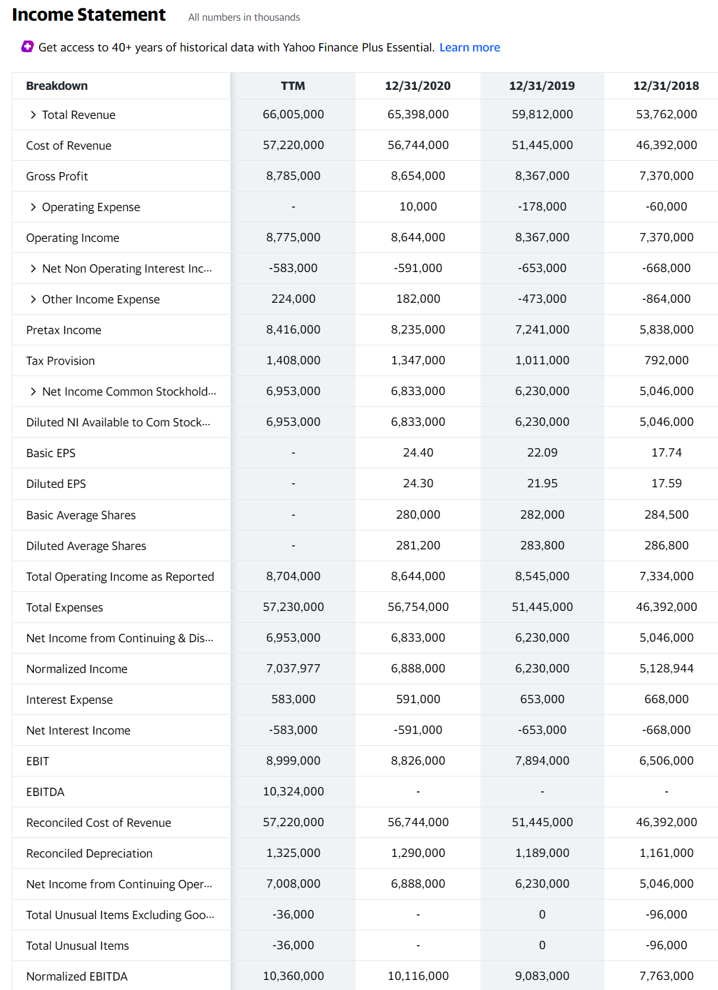
Income Statement
A quick look at the income statement of the largest U.S. Government Contractor:
Lockheed Martin Corporation ¹³

Slide 44
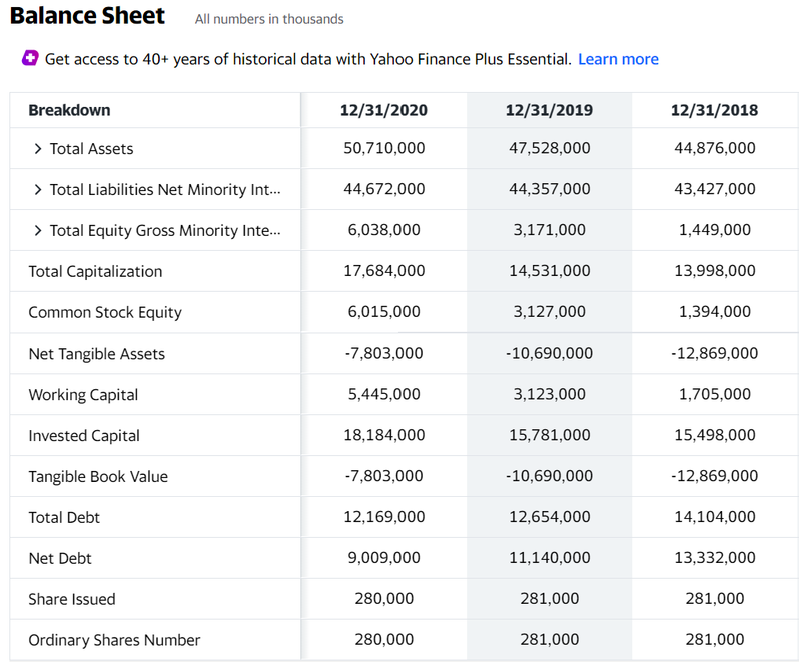
Balance Sheet
A quick look at the balance sheet of the largest U.S. Government Contractor:
Lockheed Martin Corporation ¹⁴

Slide 45
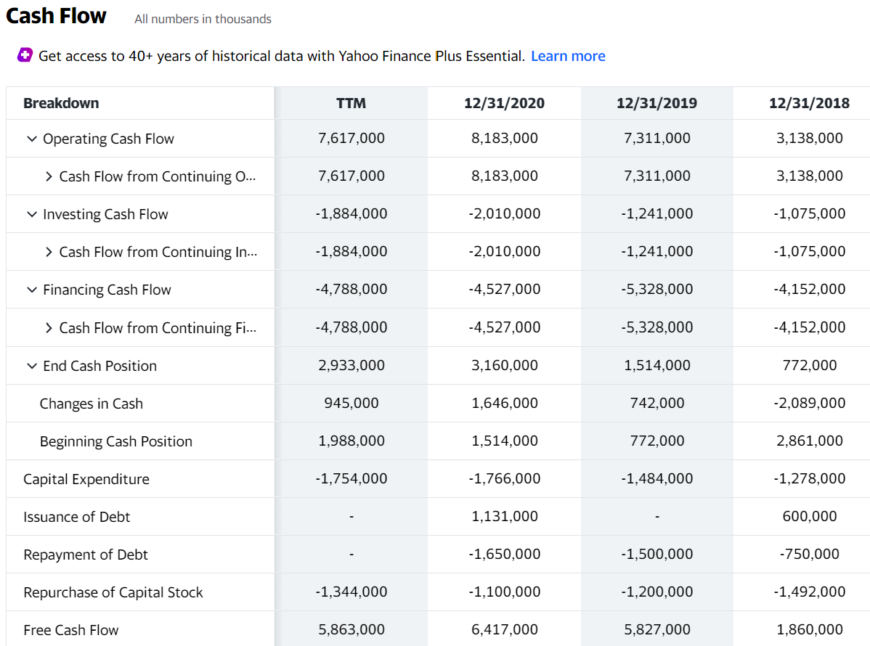
Cash Flow Statement
A quick look at the cash flow statement of the largest U.S. Government Contractor:
Lockheed Martin Corporation ¹⁵

Slide 46
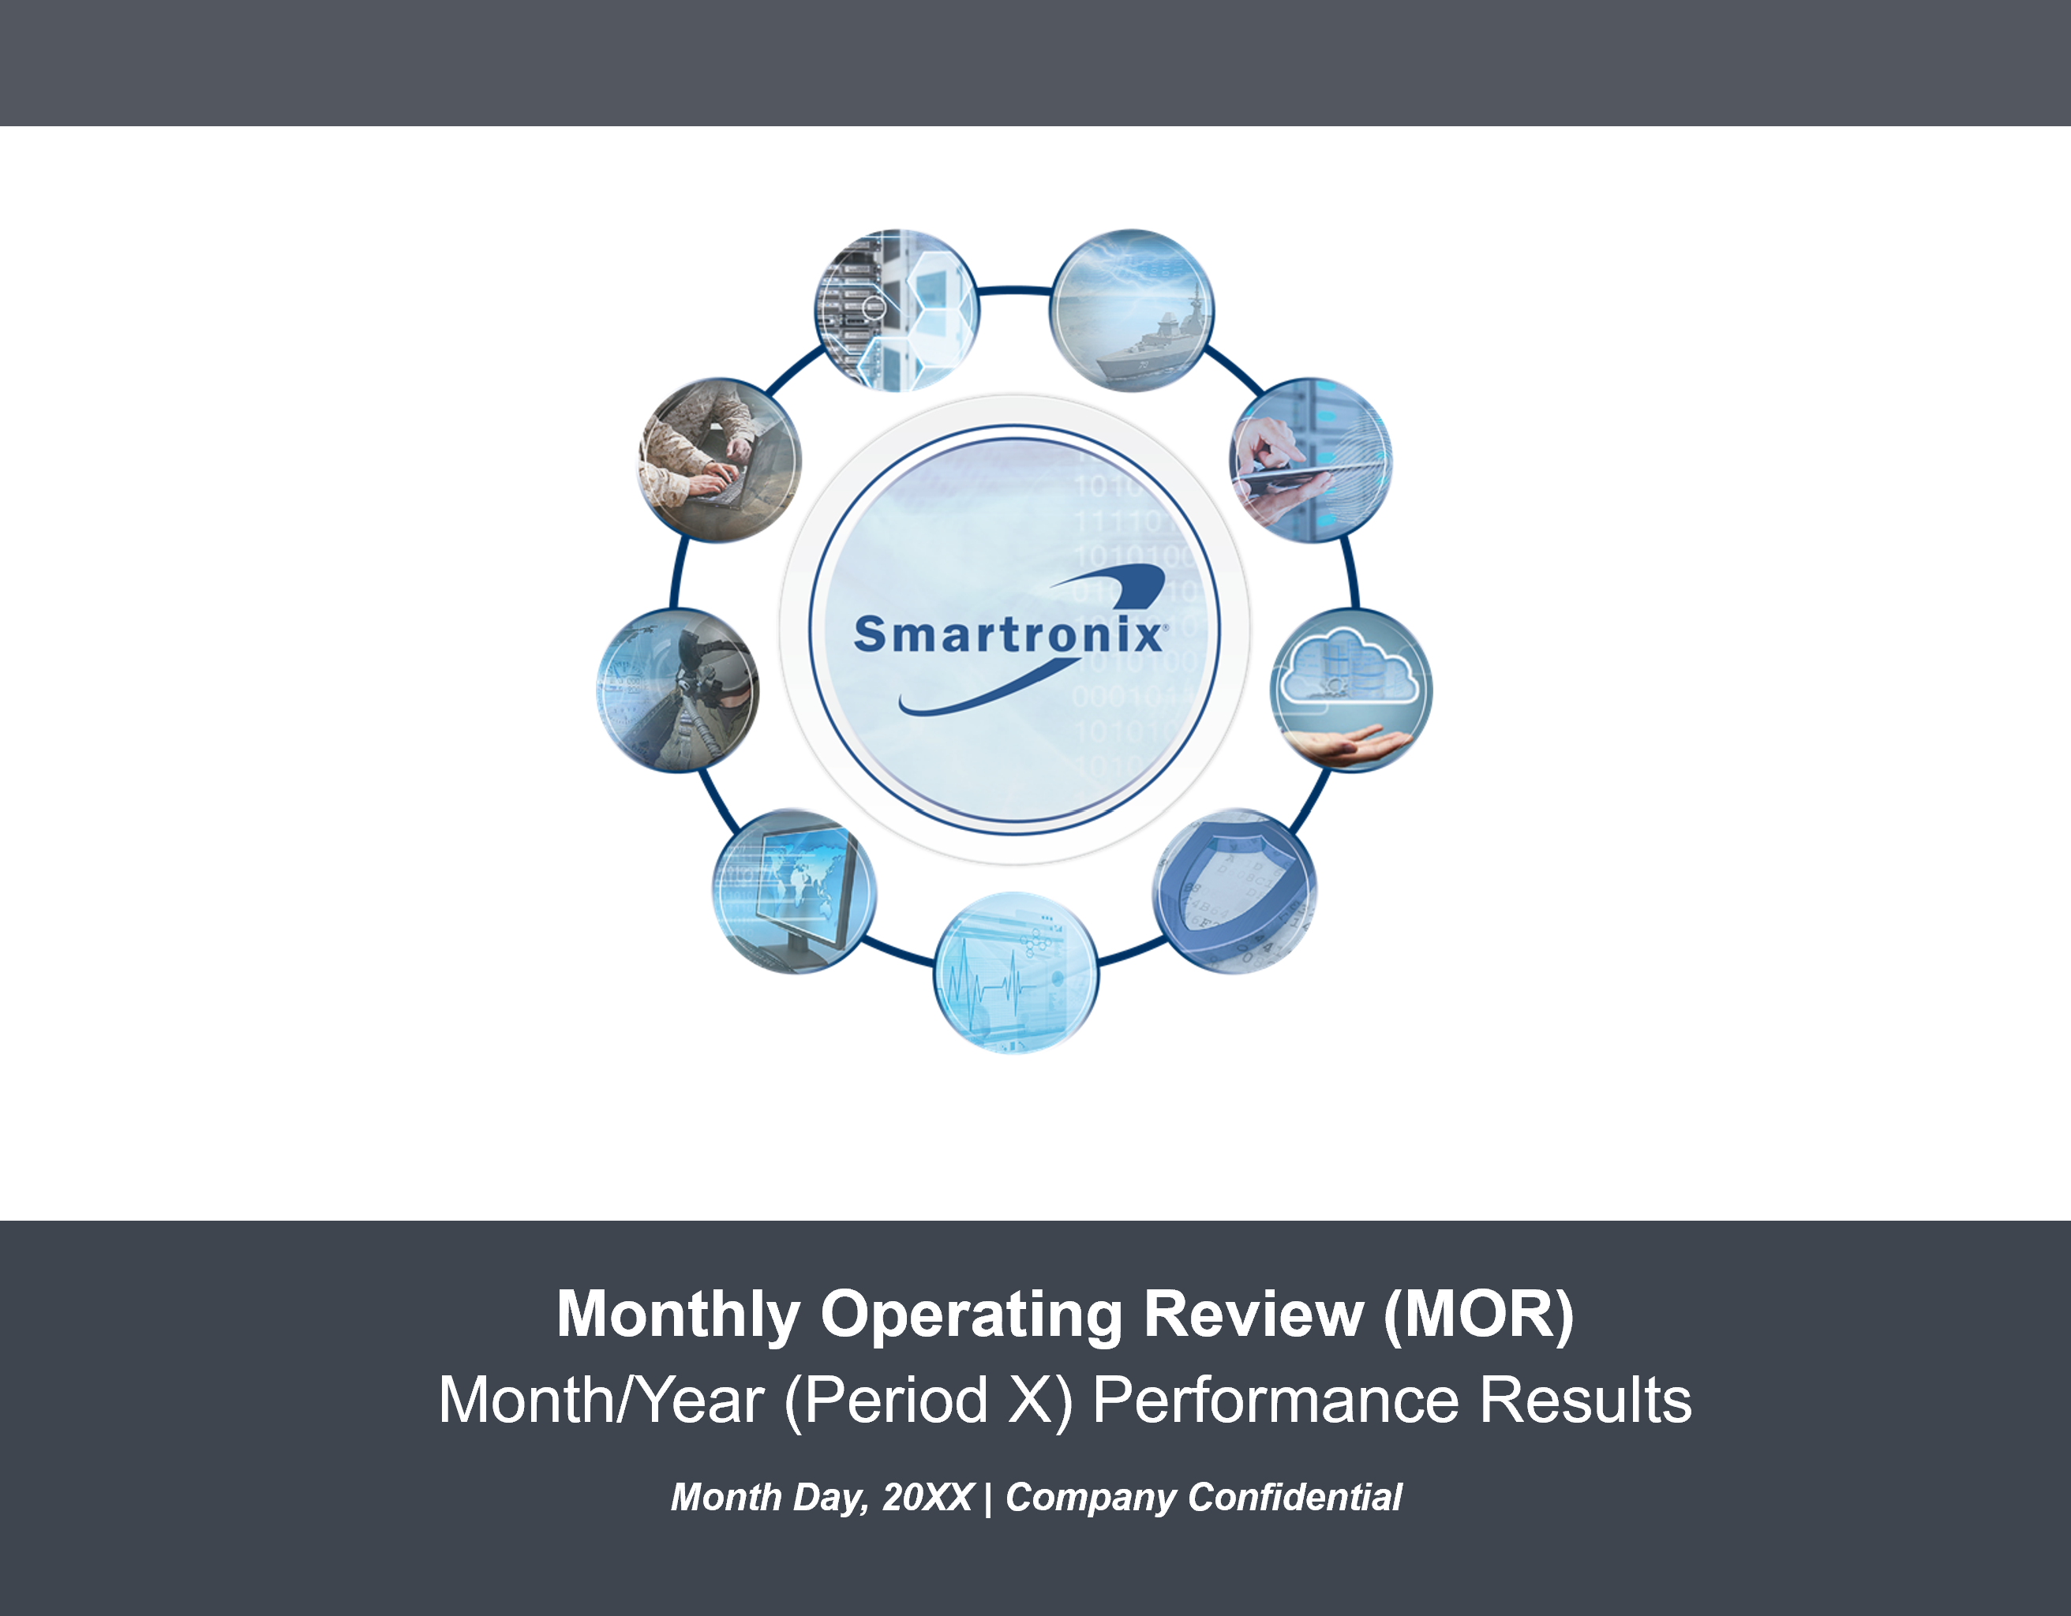
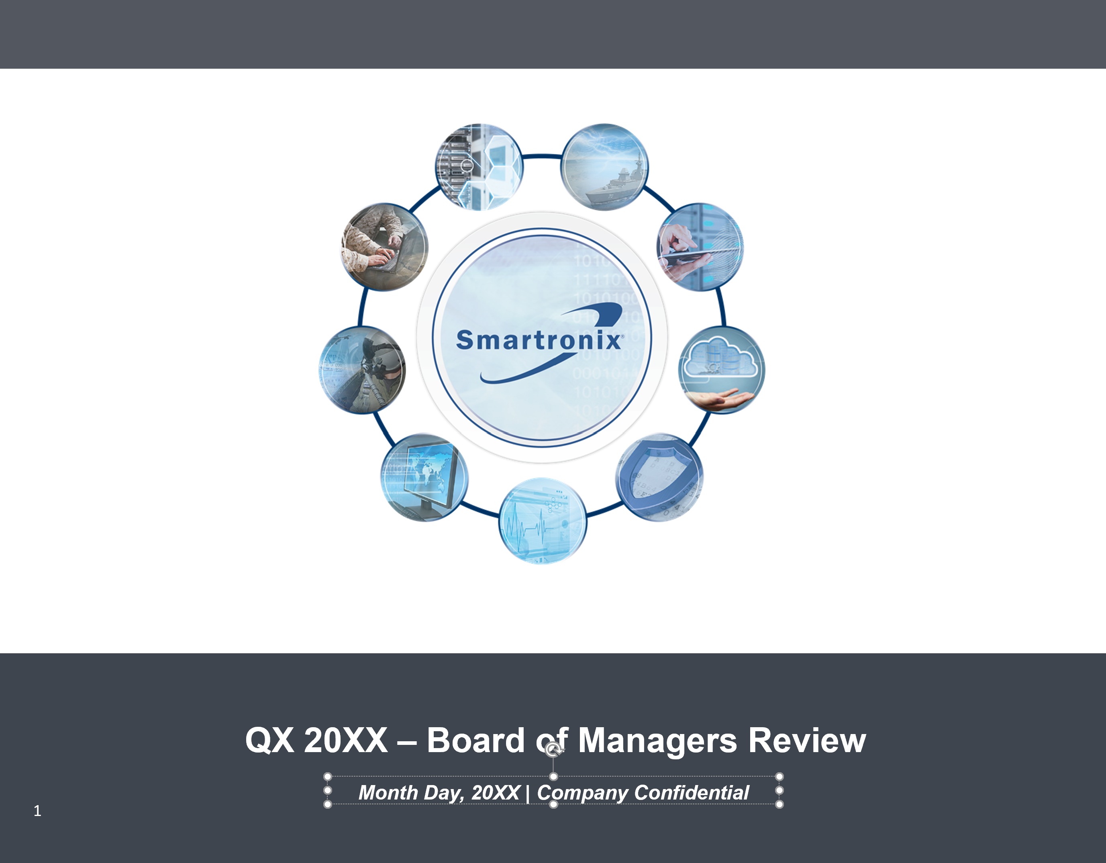
Financial Reporting Strategies for GovCon
From a CFO Standpoint, these are my two most important reports/deliverables:
Key Topics/Items of Interest
THE Playbook for running the business
~ 75 - 80 Slides with detailed operational focus
Monthly cadence, bottom’s up, heavily financial
Corp/BUs/Functions all contribute and present
Key Topics/Items of Interest
Similar to the MOR, but adds more strategy
~ 75 - 80 Slides with operational/strategic focus
Quarterly focus, bottom’s up, heavily financial
Corp/BUs all contribute and present

Slide 47


Financial Reporting Strategies for GovCon
From a Finance Org standpoint, we produce a lot of content:
Reports | Use Cases and Comments
3/5 Year Strategic Plan | ‘Tops down’ review of the company’s strategic endeavors. 3- or 5-year outlook.
Annual Operating Plan (AOP) | ‘Bottoms up’ operational construct that guides the company to meet its goals.
Monthly Financial Forecast | Detailed progress reporting that tracks performance to the AOP.
Monthly Flash Report | Simple summary table of month-end results and analysis. Shared with ELT/Board.
Monthly Financial Reporting Model | Detailed record of actual financial results. (Full I/S, B/S, SCF).
Pipeline and Growth Metric Reporting | Detailed measurements of pipeline health, book-to-bill, near term bids, et al.
Bookings/Backlog Reporting | Details of new contractual booking awards and translation into backlog generation.
Estimates at Completion (EAC) | Detailed programmatic-level reporting that determines most likely costs and profits.
Project Status Report (PSR) | Project-level reports that provide contract specific details for value, funding, costs.
Labor Utilization Reporting | Measures the efficiency of the workforce via direct charge optimization metrics.
Indirect Rate Reporting | Tracks indirect budget and rate performance by pools, expenses, and labor base.
Wrap Rate Analysis and Reporting | Analyzes aggregated indirect rate performance vs. provisional targets.
Risks and Opportunities (R&Os) Reporting | Bounds the forecast with a high/low case. Helps mitigate risks and capture opportunities.
Daily/Weekly Cash Reporting | Daily cash management tracking to ensure company liquidity and cash optimization.
Controversy Alert! I purposely don’t have a logon ID for our accounting system. It helps me stay out of the weeds and focused on strategic focus and higher-level execution. I should be able to derive all answers from the MOR, or we will add content.

Slide 48
Sample: Financial Reporting Summary (1 of 2)
This report is one of my main ‘go-to’ reports for financial analysis/insights:
Periods: TTM/Rolling
Approach: Summary of Full I/S, B/S, SCF, TB for each entity
Owned By: Finance/Controller’s Org.
Published Via: Monthly Operating Review (MOR)
Published To: ELT, BOD, Lenders
Main Benefits: Consolidated results analysis; performance MGMT

Slide 49
Sample: Financial Reporting Summary (2 of 2)
This report is one of my main ‘go-to’ reports for financial analysis/insights:
Periods: TTM/Rolling
Approach: Summary of Full I/S, B/S, SCF, TB for each entity
Owned By: Finance/Controller’s Org.
Published Via: Monthly Operating Review (MOR)
Published To: ELT, BOD, Lenders
Main Benefits: Consolidated results analysis; performance MGMT

Slide 50
Daily/Weekly Cash Report
This report is my main ‘go-to’ report for cash and liquidity management:
Periods: Daily balances, 6 weeks rolling
Approach: Bank balances, A/R, A/P, Payroll
Owned By: Finance/Controller’s Org.
Published Via: Weekly Report
Published To: ELT, BOD
Main Benefits: Cash Trend Analysis, Liquidity

Slide 51
‘Recap & Looking Ahead'
  So far, we’ve covered numerous topics including:
    An overview of Budgeting, Forecasting, and Financial Reporting: Use Cases, Ownership and Benefits
    A review of the Financial Planning Process: Strategic Plan, Annual Operating Plan (AOP), Financial Forecast
    A host of definitions, concepts, and critical elements of financial planning
    An introduction of best practices in probability-weighted new business forecasting methodologies and risk/opportunity management
    An overview of financial statements/reporting and additional best practice suggestions related to detailed reporting models and daily/weekly cash planning
Next, we’ll transition into how these concepts, theories, and ideas translate into real-world scenarios. But first…

Slide 52
Break Time!

Slide 53
A brief collection of relevant situations and experiences I’ve come across
Part 2A: Experientials & Insights

Slide 54
“85% Cost Plus; Losing Money”
  Background:
    Technology Solutions; GovCon Company
    ~ $100M of Annual Revenue
  Issue(s):
    Top line AGR of 20%+; 85% CPFF; Negative EBITDA at Enterprise Level
    Constrained Cash Flow/Conversion; Bank Covenants at Risk
    Numerous FFP/T&M loss programs; all showing as ‘green’
    Indirect rate caps limiting full absorption of indirect costs on CPFF
  Solution(s) & Outcome:
    Deep-dives into programs/contracts, indirect budgets/rates, et al
    Established new MBR and FINREP to focus on EBITDA generation
    Tied ICP’s to 100% EBITDA vs. prior Bookings/Revenue
    Revamped program metrics to show GM/OM issues vs. ‘green’ stoplights
    Reduced indirect costs/rates and increased rate caps to convergence
    Ultimately, improved EBITDA by +800 BPS over 3 years
First 30-60 days of new CFO role:
Understand ‘Stakeholder Insomnia’
Determine Finance Team’s Current ‘Reputation’
Establish Staff/Org Alignment
Review AOP/Forecast/FINREP
Review Major Programs; Drivers
Understand Pipeline
Manage R&O’s

Slide 55
“The M&A Power Play”
  Background:
    Mid-stage Due Diligence of a Buyside M&A Opportunity
    Target company was predicting explosive growth in current/out years
  Issue(s):
    Management was already set on doing the deal. ‘We like this one’.
    Heavily classified nature of the contract base made it hard to validate
    International sales expansion and related projections difficult to prove out
  Solution(s) & Outcome:
    Shredded the financial forecast (contract waterfall) and established a baseline of existing run rate services business
    Interviewed the Sellside ELT to determine aggressive/conservative nature
    Established a revised base case of revenue/profit expectations which became the basis for the deal structure. (25% ‘haircut’).
    Acquisition was completed; base case was still too optimistic (28% off).
During the M&A process, CFOs are at the forefront of establishing the Base Case financial forecasts.
Be on the lookout for recompete exposure, small business conversion risk, significant increases in staffing, international sales growth, etc. when evaluating the sellside projections.
Mastery of forecasting theory and financial statement analysis is paramount to successful buyside diligence.

Slide 56
“The Founder Who Does It ‘All’ ”
  Background:
    Founder-Owned GovCon A&D Manufacturing Firm
    ~ $80M of Annual Revenue
    Founder = CEO = COO = CFO = CTO = CGO
  Issue(s):
    Founder: “I thought my EBITDA would be $2M, it came out to be $8M”
    Over-ran USG contract by $800k. Customer threatened ‘T for D’
    Wrote-off the $800k; customer brand damaged
  Solution(s) & Outcome:
    Hired a CFO/Director of Finance (Way to go Alliance!)
    Built a program finance team
    Put in place an AOP, Forecast, and MBR’s with more financial oversight
    Business improving metrics/performance; aligned the ELT on financial performance methods
One of the best attributes of a great CFO is the ability to survey the entire business landscape:
‘You can’t enjoy the view of the entire beach by sticking your nose in the sand. It is much better to pick your head up and see the entire coastline’

Slide 57
“I’m Taking My Ball and Going Home”
  Background:
    Multi-Billion Dollar Publicly Held Company
    Conversation with a BU CFO who ran $1B+ Division
    We were discussing how to set the right level of growth targets for a business
  BU CFO Perspective and My Boss’s Boss at the time:
    His Quote on Plan Setting:
    “I’m 5’7”. If you tell me I’ll get $100 if I can dunk a basketball on a 10’ hoop I’m going to take my ball and go home. But if you give me a tennis ball and a 9’ hoop I may not make it, but I’ll train REALLY hard to give it my best shot”.
  Outcome:
    A fine idea and concept if properly put into practice
    2 weeks later I received my annual target. 100% YOY growth on an 85% cost type business with only one major backlog contract
    To say that the leadership team was distraught is an understatement
Setting the right annual growth target is challenging but very important. Set too low and people may not work as hard as they could to achieve it. Set the target too high and people will give up early in the year when they don’t think they can make it. This is magnified by how the company aligns incentive compensation to growth.
Be fair, balanced, and reasonable. Stretching is OK, but don’t risk injury.

Slide 58
A brief collection of YOUR relevant situations and experiences YOU’VE come across
Part 2B: YOUR Experientials & Insights

Slide 59

Scenarios: Now It’s Your Turn!
      Budgeting, Forecasting & Financial Reporting
  Background:
    Provide some context and set up the scene
    What was your role in the situation?
  Issue(s):
    Define the business concerns and/or problems you faced
  Solution(s) & Outcome:
    What did you do to solve the problem?
    What specific actions, strategies, tactics did you put in place?
    What were the results?
    Did the solution ‘hold’?
    What was the outcome?

Slide 60
What’s On Your Mind?
Part 3: Open Q&A and Forum

Slide 61
Closing Remarks
  Sourced from my ‘Lunch and Learns’, New Hire Orientations, and ‘All Hands’:
    ‘Understand the financial implications of your day-to-day decisions’.
    ‘Closely manage your programs, cost spends, profit levels, revenue trends, R&O’s and cash’
    ‘Communicate early and often any material changes to your business/program/function’
    ‘Remember that everyone can influence the cost of doing business. Spend every dollar as it if were your own and consider that if this were your business would you still spend the money?’
    Always ask your key stakeholders ‘What keeps you up at night and how can I help?’
    Be inquisitive, humble, approachable, teamly, and responsive.
    Remember to uphold all the great words that start with ‘P’: People, Planet, Profit, Purpose as well tried and true favorites like ‘Polished, Polite, Professional, Perseverance, Progress, and Performance’
    Drive results. We all make a difference.
    Always Meet Your Commitments
And we finish where we started: “Work Smart, Work Hard, Work Fast, Go (or Stay) Home”

Slide 62
Thanks very Much and now over to Brian!

Slide 63
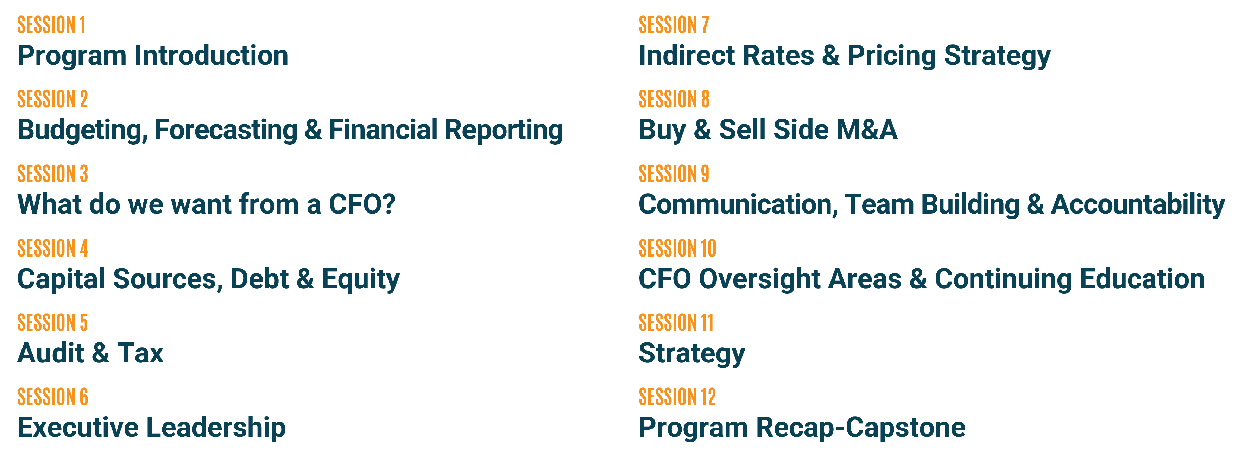
Wrapping Up
Event | Schedule
Arrival & Networking | 5:30PM – 6:00PM
Main Presentation | 6:00PM – 8:30PM
Wrap-Up & Continuation | 8:30PM +
Next Session – August 18, 2021

Slide 64
Wrapping Up
End Note Reference | End Notes & References
1 | What Is a Business? | Boundless Business (lumenlearning.com)
2 | 10 Gordon Gekko Quotes That Will Change The Way You Think About Investing - Wall Street Survivor
3 | The Dumbest Idea In The World: Maximizing Shareholder Value (forbes.com)
4 | What Is the Purpose of Business? | HuffPost
5 | 3 Reasons Why a Strong Purpose Is a Good Business Idea (entrepreneur.com)
6 | BUDGETING | meaning in the Cambridge English Dictionary
7 | FORECASTING | meaning in the Cambridge English Dictionary
8 | FINANCIAL REPORTING | meaning in the Cambridge English Dictionary
9 | The Importance Of Financial Reporting & Analysis: Your Guide (datapine.com)
10 | Why Budgeting Is Important (Plus 7 Benefits of Budgeting) | Indeed.com
11 | Benefits or Advantages of Budgeting to organization (accountlearning.com)
12 | 8 Advantages of Forecasting Your Business Revenue - Fully Accountable
13 | LMT 381.49 1.27 0.33% : Lockheed Martin Corporation - Yahoo Finance
14 | LMT 381.49 1.27 0.33% : Lockheed Martin Corporation - Yahoo Finance
15 | LMT 381.49 1.27 0.33% : Lockheed Martin Corporation - Yahoo Finance
Category | Suggested Reading & Additional Learning Opportunities
Industry Reporting | 2020 GAUGE Report: Government Contracting Trends and Data (cohnreznick.com)
Definitions/Learning | Investopedia: Sharper insight, better investing.
Public Company Info | Yahoo Finance - Stock Market Live, Quotes, Business & Finance News
Learning Guides | DAU Home
Notes:
Mandatory slide for sources, references, end notes, links, etc. Presenters should include any objective evidence as applicable.

Slide 65


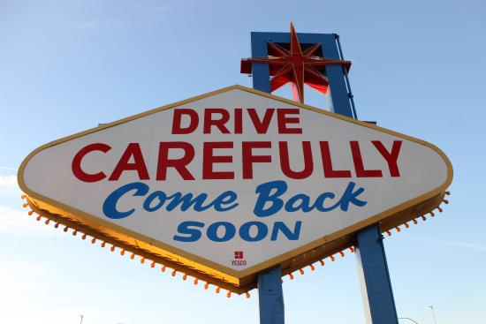
Thanks, and see you soon!

