Slide 1
The future of secure mobility.
CFO RISING PRESENTATION – M&A PROCESS
Rich Sawchak, CFO, rich.sawchak@hypori.com
Hypori.com

Slide 2
Today’s Agenda
1. Why do companies acquire other businesses?
2. How to assess an acquisition target?
3. Valuation techniques (Buy/Sell) Market Comparables Acquisition Comparables Discounted Cash Flows / Terminal Values
4. Paying for the acquisition (Financing) Acquiror’s Cash / Target’s Cash Raising New Equity / Debt Seller’s Notes / Earn-outs / Deferred Comp
5. Integrating the acquisition (WaveStrike/Accenture)
6. Determining whether an acquisition was successful
7. What happens after you sell the company you’ve been building (Personal Career)
2

Slide 3

A Bit about the Presenter
Rich Sawchak, CFO & Corporate Secretary
Joined Hypori in October 2021 after 9+ years with Novetta
Sold Novetta to Carlyle and Accenture
20+ years of leadership roles with extensive experience in the execution and integration of acquisitions as well as financings
Responsible for all areas of finance, accounting, sales ops, compliance, legal & HR/recruiting
Prior to Novetta, Rich was EVP & CFO at Shafer Corporation and was SVP & CFO at Paradigm Solutions, where during his tenure Paradigm was purchased by CACI
Member of the board for SPA, Inc. and GCA/networked, and trustee of University of Valley Forge
Holds a B.S. from Boston College and a Master’s in Entrepreneurial Finance and Strategic Cost Management from Babson College
Resides in Leesburg, VA with wife Jenn and daughter Ally; 2nd dan blackbelt in taekwondo
3

Slide 4











Hypori Overview
Standalone Delaware C-corporation during 2021
Founder led by CEO Jared Shepard with experienced leadership team including CPO Jim Cushman and CFO Rich Sawchak
Largest Classified mobility provider in DoD with over 13k licenses in SOCOM and growing
Only DOTE / DoD tested Security platform with ZERO significant security risks; red team said, “Most secure technology tested to date”
Pending approval from DoD CIO for Cyber as the “only BYOD capability in the DoD”
Growing ARR within current annual revenues of $12mm
~100 employees with significant presence in Austin, TX
Series A investment led by Great Point Ventures
Current Customers
Awards & Recognition
4

Slide 5



















Novetta Overview
2012
$0.4B
1.3K
FOUNDED
ANNUAL REVENUE
EMPLOYEES
DATA
ANALYTICS
MULTI-INT
FUSION
OPEN SOURCE
ANALYTICS
FULL-SPECTRUM
CYBER
CLOUD
ENGINEERING
MACHINE
LEARNING
DEVSECOPS
5

Slide 6
Successful M&A Growth Process
Formalize vision and corporate milestone goals in order to build consensus on long-term objectives
“Laying the Groundwork”
“Build Acquisition Pipeline”
“Sell the culture and vision”
“Close the deal & Integrate”
1
7
1
4
9
Develop Growth Strategy
- Establish growth objectives
- Know why you’re using M&A
for growth
- Understand shareholder risk appetite
- Understand financing options & limitations
- Develop ideal market and customers, prospect criteria
- Create company overview presentation
- Plan due diligence & integration
Identify Acquisition Targets
- Develop prospect pipeline
- High-level screen, e.g.
services, capabilities, contract vehicles, employees, annual revenue
- Pipeline from i-bankers
Meet with Owner
- Gauge interest
- Gather critical decision-
making information
Propose & Negotiate
Agreement
Outline offer process
including IOI or letter of intent (LOI)
Plan additional site visits &
market contacts
Mutual interest, proceed with discussions
Tailor introductory presentation
Sign CA (as appropriate)
5
Gather Prospect Information
- Create prospect profiles
for team review
- Rank & rate prospects
against criteria
8
10
Schedule Second Visit
- “Sell” vision/culture to owner
- Continue to build relationship and trust
- Understand owners go-forward strategy and organizational fit
Conduct Final Due Diligence
- Complete due diligence
checklists
- Site visits & market contacts
- Refine integration & business
plans
- Modify valuation and deal
structure
2
Identify Potential Markets
- Brainstorm universe of
markets/customers/contract vehicles to research
- Prioritize “short list” of
markets for initial research
Proceed
with
negotiations
Prospect appears attractive
Yes, Board decision; final negotiations
6
Determine Owner’s Interest
in Selling/Partnering
- Contact owner
- Determine interest &
motivations
11
3
Continue meeting and data gathering
Acquire & Integrate or Partner with Prospect
- Address functional issues
- Definitive Purchase
Agreement & consummate
transaction(s)
- Formalize integration plan
Analyze Potential Markets
- Research and evaluate
markets and segments
- Identify attractive niches
and entry options
6

Slide 7
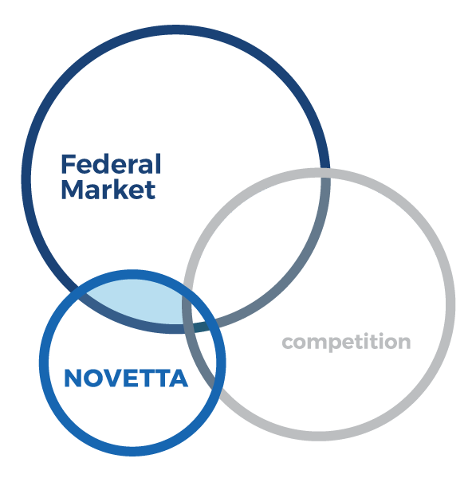
Acquisitions Aligned to Growth Strategy
TARGET CUSTOMERS
Intelligence Community, Special Operations & Military Intelligence, USCYBERCOM, Homeland Security, Federal Law Enforcement
Core capabilities are aligned with Defense and Intelligence Community priorities.
Out of Bounds: LPTA, SETA, opportunities “outside of core discipline” & commodity services.
Prime and expand foothold in high barrier to entry customer spaces.
Investments in Machine Learning & Artificial Intelligence.
Investments in multi-cloud approach.
Continue expansion of IDIQ’s and active pursuit of TO’s via IDIQ PMO.
  Focus on Technology-enabled Services:
    Software Development
    Machine Learning / Artificial Intelligence
    Big Data Analytics
    Cloud Integration & Development
    Biometrics
    DevSecOps
    Social Media & Media Analytics
    Computer Network Operations
    Incident Response / Threat Hunt / Forensics
    C4ISR / Multi-INT Fusion
    Processing Exploitation Dissemination (PED)
7

Slide 8
Strategic Fit Considerations Via KPIs
Key Performance Indicator | Threshold
Revenue Growth | >10%
Bidding Pipeline of Opportunities | Breadth / Depth
Profitability (EBITDA %-Revenues) | >10%
Cash Flow Generation | Low NWC / CapEx Requirements
Technology & Technical Investments | IR&D / Certifications / Competencies
Headcount (Billable Growth) | >10%
Retention (Total, Unadjusted) | >90%
Book-to-Bill (Funded) Book-to-Bill (Total) | Consistent with Growth Expectations
Backlog (Total, Multi-year) | Multiple of Revenue / No Significant Recompetes
Prime Contracts (%-Revenues) | Solid Majority
Culture / Core Values | Deal Maker / Breaker
Proprietary Products / Technology
Access to Key Customer(s)
Strong financial performance
Recurring revenue stream
High margins
Strong culture & management (that fits)
Vertical integration
Cross-selling products with existing services
Market access and growth potential
Future capabilities
8

Slide 9
M&A Growth Rationale
MARKETS/CUSTOMERS
 | EXISTING | NEW
E X I S T I N G | Consolidation Get deeper in current markets/customers; acquire competitors in current market | Market/Customer Penetration Bring services and/or competencies to new markets
N E W | Breadth Add complementary products/services to existing markets/customers | Diversification Offer new products and technologies to new markets; typically most risky
PRODUCTS/CAPABILITIES
Additional customer accounts; market share expansion
Past Performance
Expand geographic coverage
Management and sales talent
Contract Vehicles
Diversification into a growing market
New customers and geographic reach
Cash flow and profitability (taking existing capability vs. investing in new)
1
3
2
4
Cross selling of products
New capabilities/complementary to current products (value add)
Selling into same customer base (deepen client relationships)
Typically less risky than entering new markets
Diversification of cash flow
New core competencies and capabilities
New customers and geographic reach
New markets
Diversification of cash flow
9

Slide 10
Managing the Pipeline of Targets
Research &
Evaluate
60+
Contact
owner
30
2nd Visits
5-6
Identify 100+
1st Visits
10-12
Negotiations
2-3
Close
1+
Identify | Once target markets and segments are selected, develop initial pipeline of at least 100 prospects Perform high-level screen (services, products, size, position) to prioritize research efforts
Research & Evaluate | Develop prospect screening data and prioritize candidates Review prospects during strategy team reviews/meetings Assume team will pass on 50% (and 50% of those evaluated continue forward)
Contact Owners | Determine decision makers interest in partnering and gain further insights
First Visits | Once several prospects move beyond disclosure
Second Visits | Anticipate one-half of prospects move forward following first meeting
Negotiations | Recommend on-going negotiations (beyond first meeting) with at least two or three prospects simultaneously
Close | Based upon experience, expect one to two strategic agreements for every 100 candidates
10

Slide 11


M&A Growth Rationale - Examples
MARKETS/CUSTOMERS
 | EXISTING | NEW
E X I S T I N G | Consolidation Get deeper in current markets/customers; acquire competitors in current market | Market/Customer Penetration Bring services and/or competencies to new markets
N E W | Breadth Add complementary products/services to existing markets/customers | Diversification Offer new products and technologies to new markets; typically most risky
PRODUCTS/CAPABILITIES
1
3
2
4
11

Slide 12
WaveStrike at a Glance
  Founded in 2010 by Anne and Mike Wagner
  Headquartered in Annapolis Junction, MD
  Leading pure-play provider of software engineering solutions for key customers within the Intelligence Community
  Focused on key capabilities including agile software development, data analytics, cloud computing, workflow and process automation and data visualization
  Double-digit revenue growth and margins for several years
  Over 100 highly-cleared technology experts including software engineers, cloud system administrators, and system engineers
  Prime contractor on coveted intelligence contracts
12

Slide 13
WaveStrike Transaction Timeline
Letter of Intent
Diligence & Document Negotiation
Initial Discussion
January 2020
February 2020
March to May 2020
Growth & Integration
Closing
Financing
April to May 2020
June 2020
June 2020 Onward
February 2020 Onward: Integration & Growth Strategy Discussions
13

Slide 14
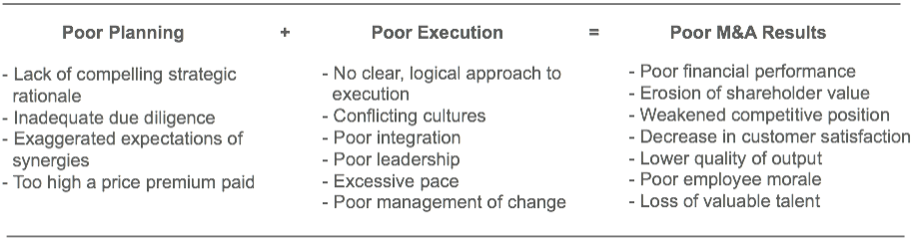
Integration is Key to Success
M&A deals fail more often than not. Study after study put the failure rate at over 70%
Integration needs to be a core capability if you pursue M&A
Source: “Making Strategy Work,” by Lawrence Hrebiniak, by Pearson Education Inc. Publishing as Wharton School Publishing, New Jersey, 2005
14

Slide 15

Novetta Sale to Accenture
  Created strategic plan which outlined when and how we would go to market – achieved the final KPIs in late 2020
    Set the strategic plan KPIs in 2017
  Kicked-off the sales process in early 2021 – hired bankers in February
  First management presentations in April – diligence & negotiations in May
  Signed deal May 27 and closed August 18
  Extremely competitive process with only 10 participants
  Bankers drove speed and certainty for sellers
  Alignment of strategies and synergies drove an outcome that was outstanding for all parties
  …….So, what did I do on August 19?.......
15

Slide 16
Thank you!
Questions??
16

